Slide 1
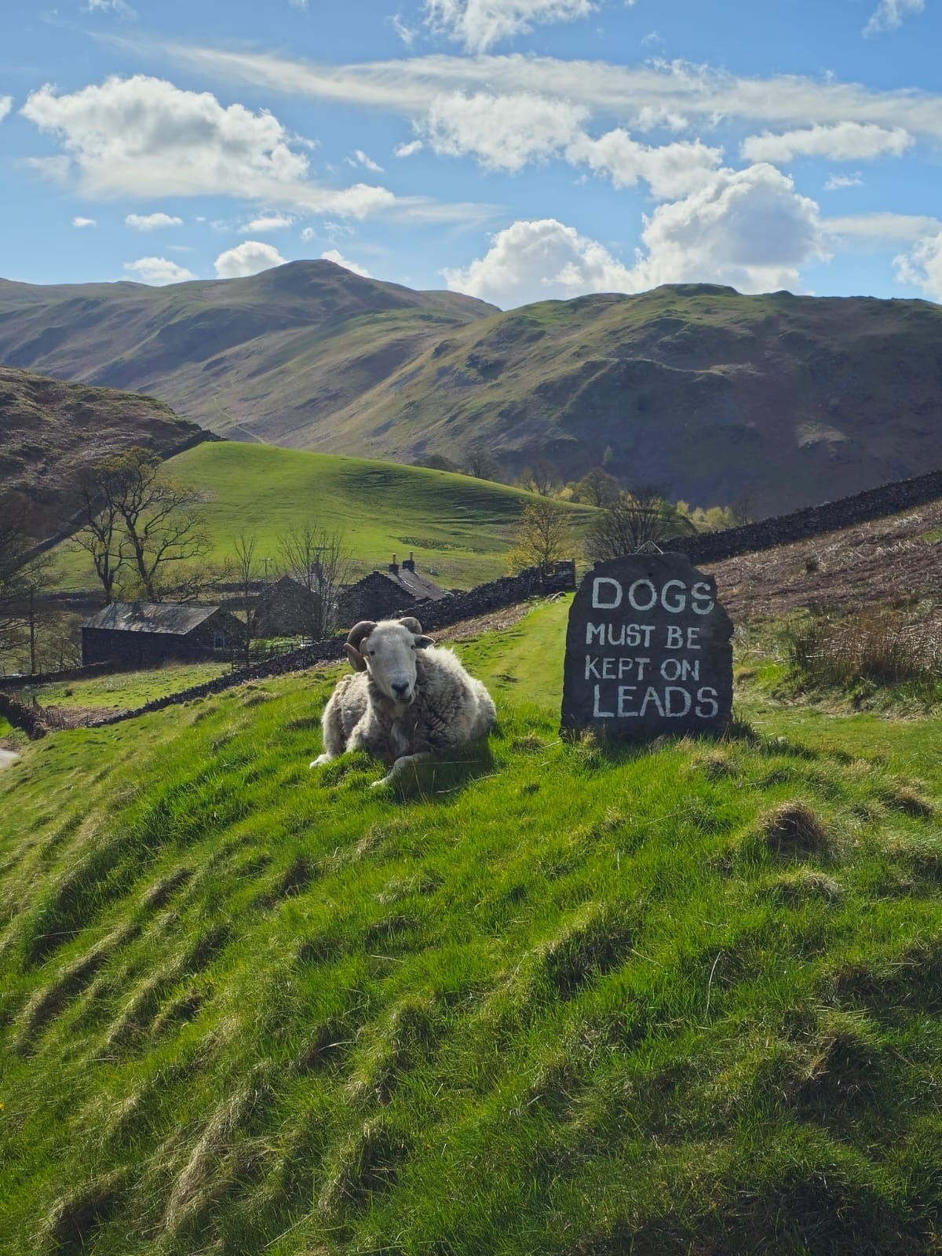

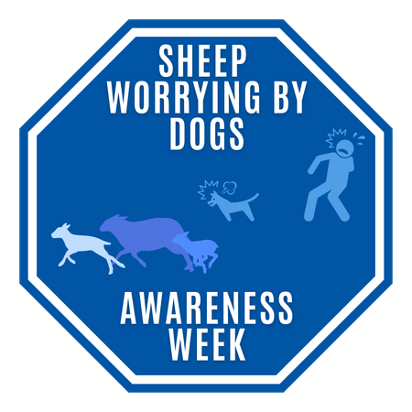
NSA sheep worrying by dogs survey results 2026
Notes:
Thanks for joining us as we kick off NSA's sheep worrying by dogs awareness campaign by sharing the annual survey results.
House keeping:
- cameras off until end as this will be recorded
- questions held until end where we will invite attendees to turn cameras on and ask them directly.
Been running sheep farmer survey's since 2013.

Slide 2
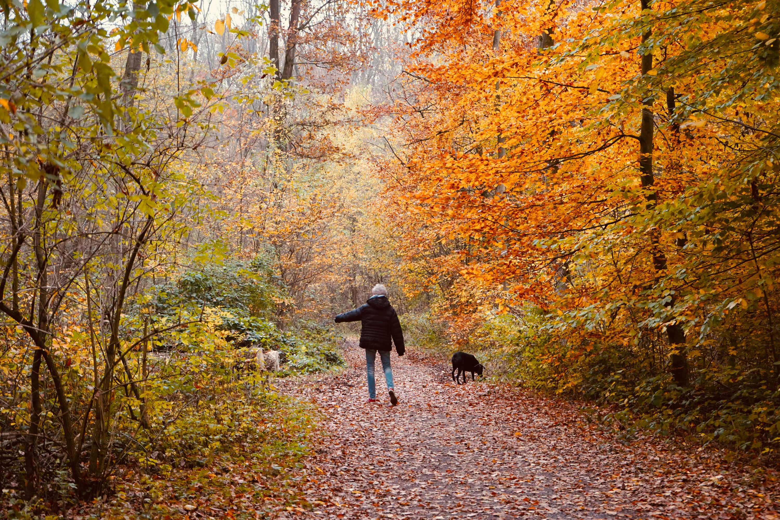

NSA’s first survey of dog owners
2,045 responses from dog owners/ walkers across the UK.
82% England, 13% Scotland, 4% Wales and 1% Northern Ireland.
Notes:
Here is a summary of the data collected in this year's survey.
For the first time, NSA has gathered insight directly from the UK’s dog-owning public, with over 2,000 respondents completing it.
The majority were from England.

Slide 3
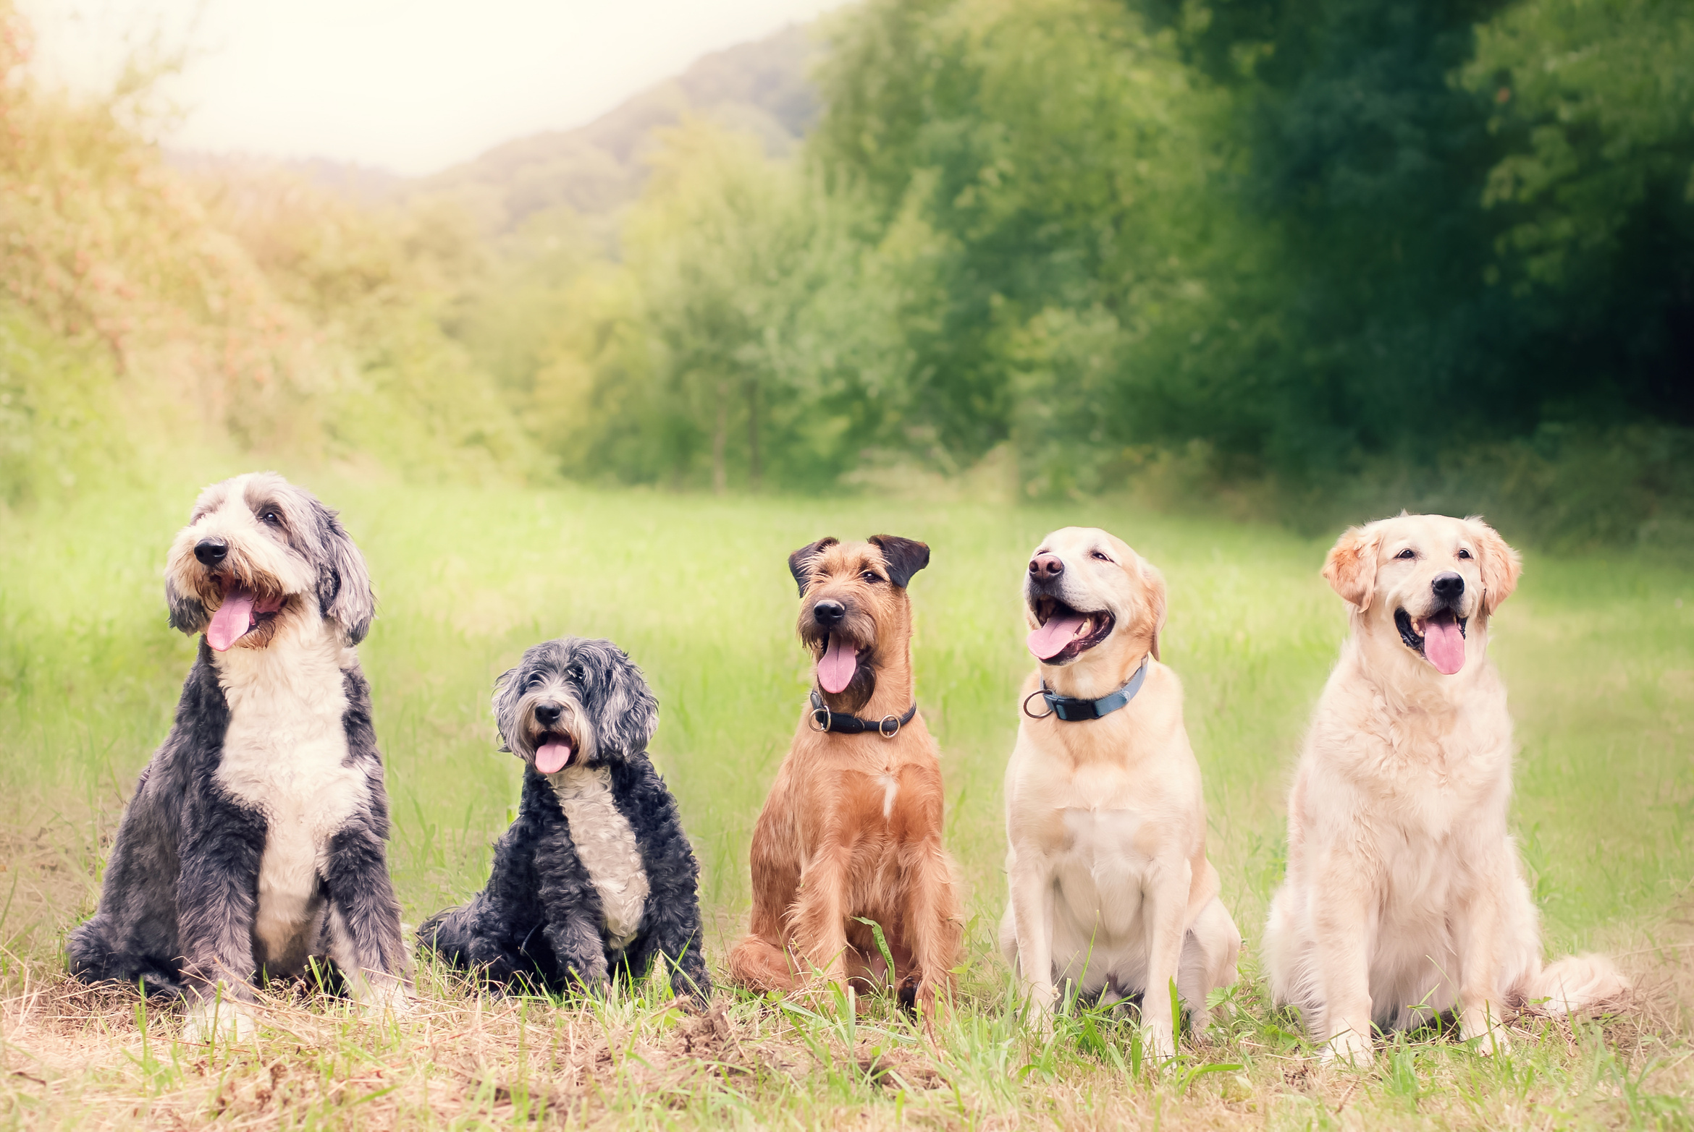
Why dog owners?
Sheep worrying occurs when a dog(s) chases and/or physically attacks sheep causing significant stress and subsequent problems, including miscarriage of lambs, physical injury and sadly in many cases, death of the animals affected.
To continue to raise awareness of these incidents and find ways of improving education, guidance and cooperation, NSA invited dog owners from across the UK to contribute to the survey.
Notes:
Sheep worrying by dogs is a significant concern, and it’s important to understand why we’re focusing on dog owners specifically.
Sheep worrying occurs when dogs chase or attack sheep, leading to stress, injuries, and even death. The consequences are severe, including miscarriages in sheep and substantial distress for farmers. This is why engaging dog owners in the conversation is crucial.
By involving dog owners through the survey, NSA aims to increase awareness, educate on responsible dog ownership, and foster cooperation. This effort hopes to prevent these distressing incidents and promote safer interactions between dogs and livestock.
Ultimately, our goal is to reduce these incidents and their impact significantly.

Slide 4
Headline messages
  Sheep worrying is widely recognised but not fully understood.
  Dog walking near sheep is routine and high-risk.
  “Under control” is a grey area putting sheep at risk.
  Awareness of penalties is high - but gaps remain.
Notes:
First, while sheep worrying is widely recognized, it's not fully understood. This gap in understanding can lead to dangerous situations for both sheep and dogs.
Secondly, walking dogs near sheep is common but presents a high risk. The concept of having a dog "under control" is often a grey area, leaving sheep vulnerable to unexpected attacks.
Finally, although awareness of the penalties for sheep worrying is relatively high, there are still significant gaps in knowledge that need to be addressed.
These insights highlight the need for better education and communication strategies to protect both our national flock and dogs.
Let's take a look at the survey results in more detail...

Slide 5
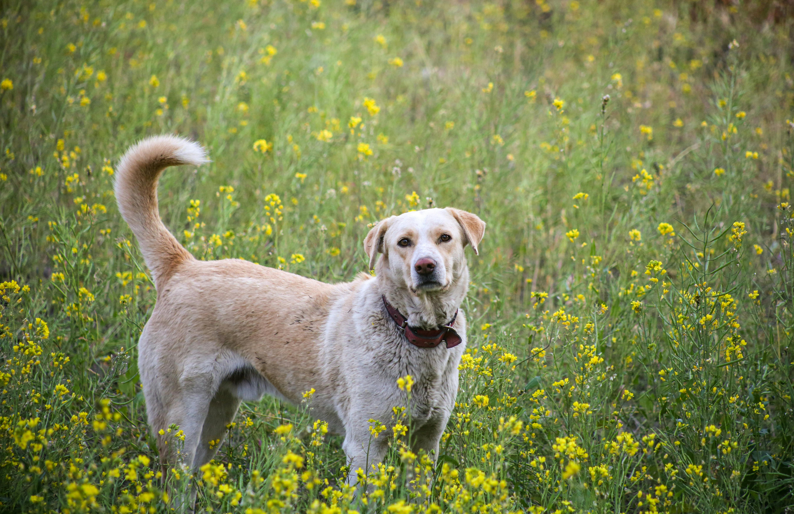

What best describes where you live:
Notes:
To get an idea of where the respondents were based, we asked them to describe where they lived.
With most saying they lived in a village or small town - suggesting the opinion of those responding would be use to coming across livestock on their dog walking routes.

Slide 6
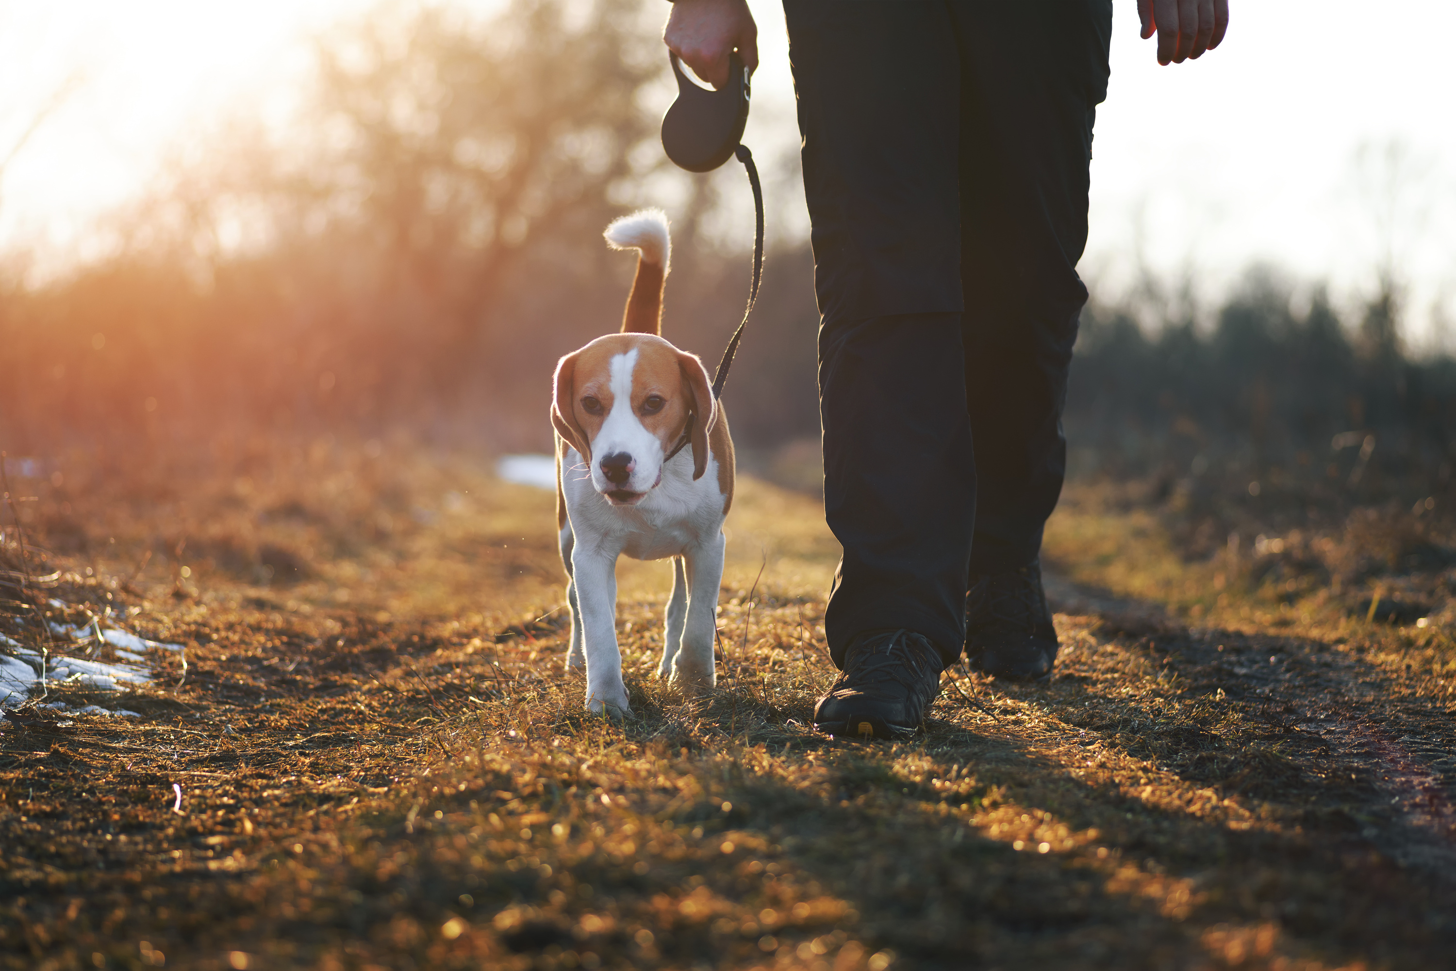
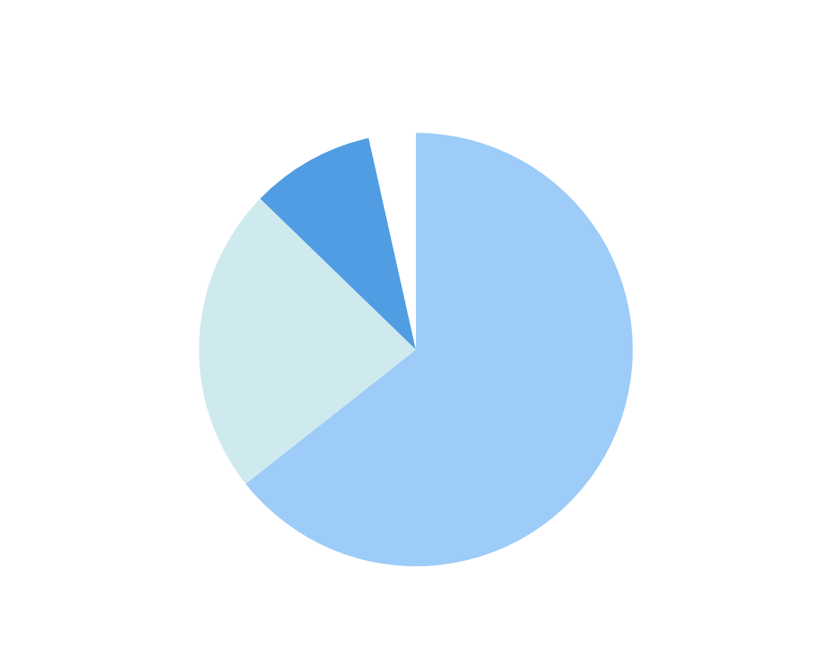
How often do you walk your dog(s) in the countryside or near farmland?
Notes:
This was confirmed with almost 65% of respondents walking their dogs in the countryside or near farmland daily, with almost 90% at least 2-3 times a week.
We often take for granted these beautiful, expansive areas, but they are also spaces where livestock like sheep are grazing. Walking our dogs in these environments can inadvertently put these animals at risk of stress or harm.
It's important to recognize that each walk represents an opportunity to ensure the safety of both our dogs and the livestock. By being aware of our dogs' behavior and keeping control, we can help minimize the risks associated with these encounters.

Slide 7
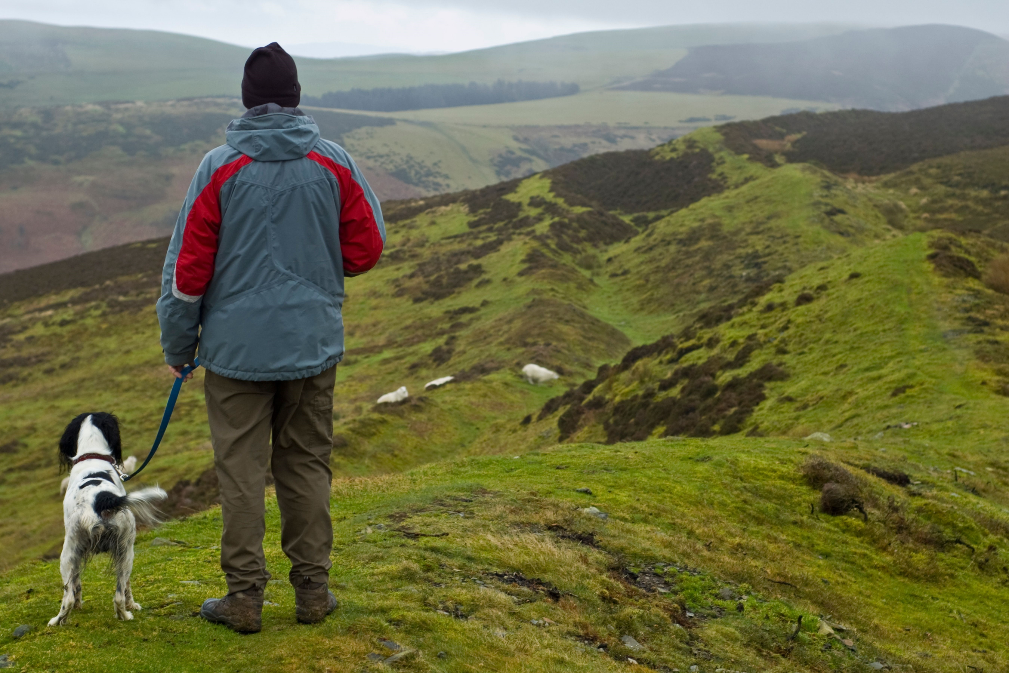
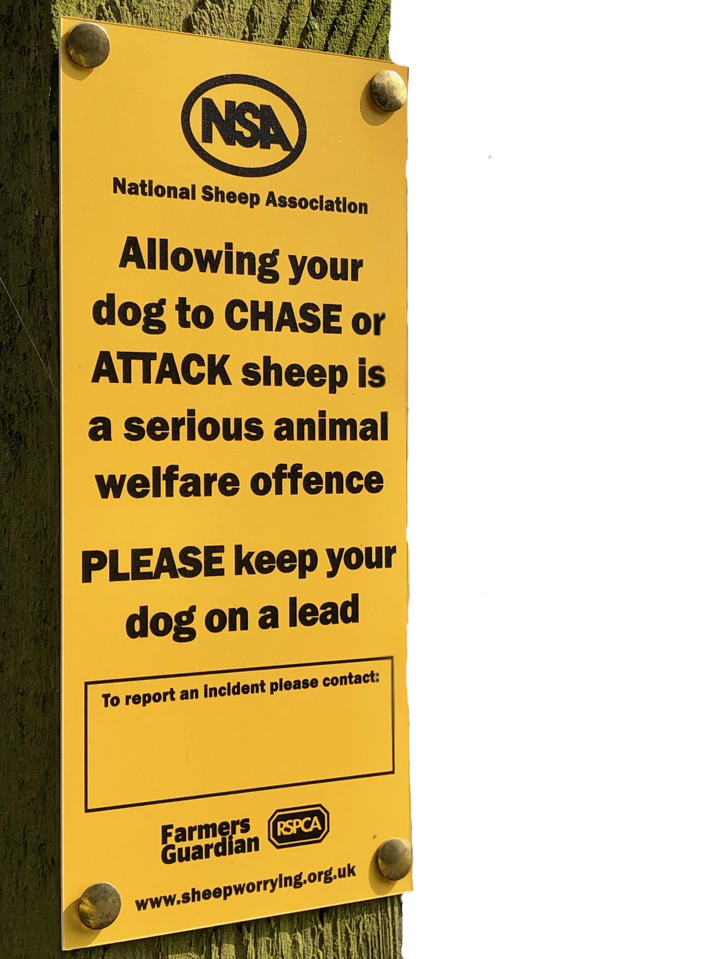

How often do you encounter sheep during walks?
Notes:
Just under half of the respondents encountered sheep at least 2-3 times a week, with 21% of them saying it was a daily occurence.
This question is crucial because it highlights the potential frequency of interactions between dogs and sheep.
Remember, being mindful of these interactions is key to ensuring the safety of both your dog and the livestock you encounter.

Slide 8
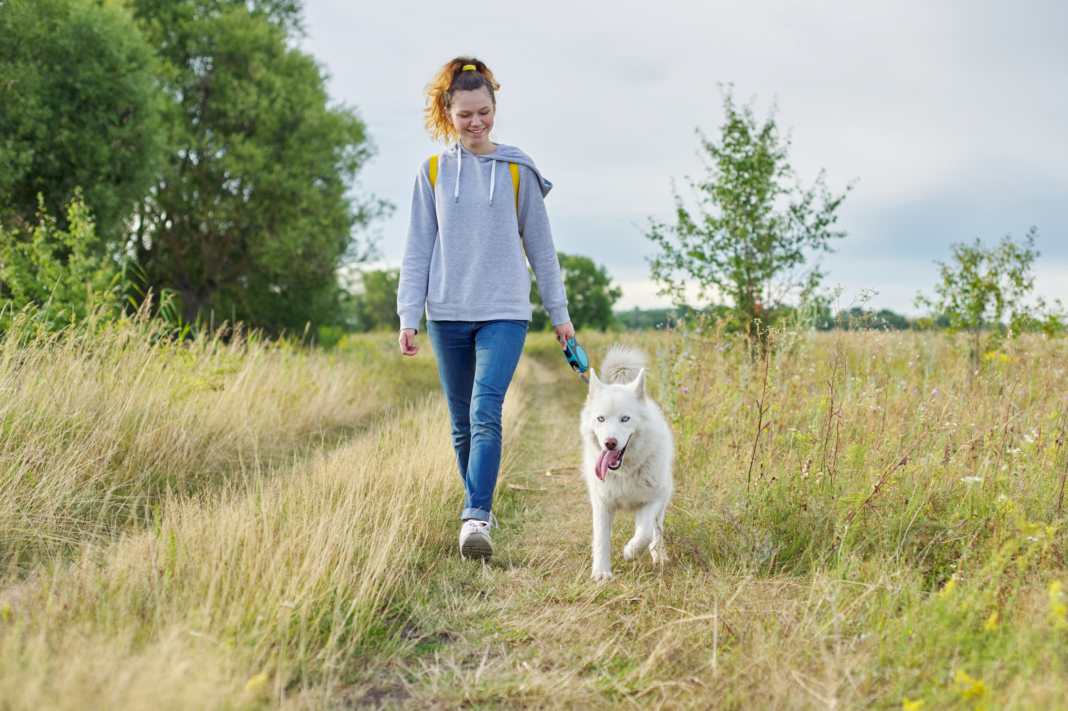
Dog walking near sheep is routine and high-risk.
Nearly 9 in 10 (85%) live within 2 miles of grazing livestock.
Most regularly walk on farmland.
This everyday behaviour creates a frequent risk exposure.
Notes:
Living close to farmland means that many of us are just a short walk away from grazing livestock.
With nearly 85% of people living within two miles of these areas, it’s no surprise that walking dogs on farmland is a common practice. However, this routine activity presents a significant risk.
Our regular walks near sheep aren’t just casual strolls; they are high-risk situations for both the livestock and our dogs. It's crucial to recognize the potential dangers and take steps to mitigate them.
By understanding the frequency of these interactions, we can better prepare to handle them responsibly. Let's be conscious of this risk every time we head out for a walk with our furry companions.

Slide 9
Behaviour and risk
1 in 8 dog owners report involvement in a sheep worrying incident.
Real-world impact is significant and not rare.
Most owners say they would act responsibly, but not all do.
79% would use a lead when seeing sheep, leaving a critical minority (1 in five) at risk of incidents.
Dog escapes are a hidden threat.
16% have experienced dogs escaping gardens, creating an uncontrolled, unpredictable risk to livestock.
Notes:
Delving deeper into behaviour and risk, now we understand a little about the demographics of the respondents...
First, it's notable that 1 in 8 dog owners report their involvement in a sheep worrying incident.
This statistic underscores the significant and unfortunately not uncommon impact of such incidents. Even though many dog owners assert they would act responsibly, there's still a concerning gap. While 79% of owners say they would use a lead upon seeing sheep, that leaves a critical minority - 1 in 5 - who might not take this precaution.
Furthermore, dog escapes present a hidden threat. With 16% of dog owners experiencing their dogs escaping from gardens, this creates an unpredictable risk to livestock that needs addressing.
These insights highlight the importance of continued education and proactive measures to mitigate these risks.

Slide 10
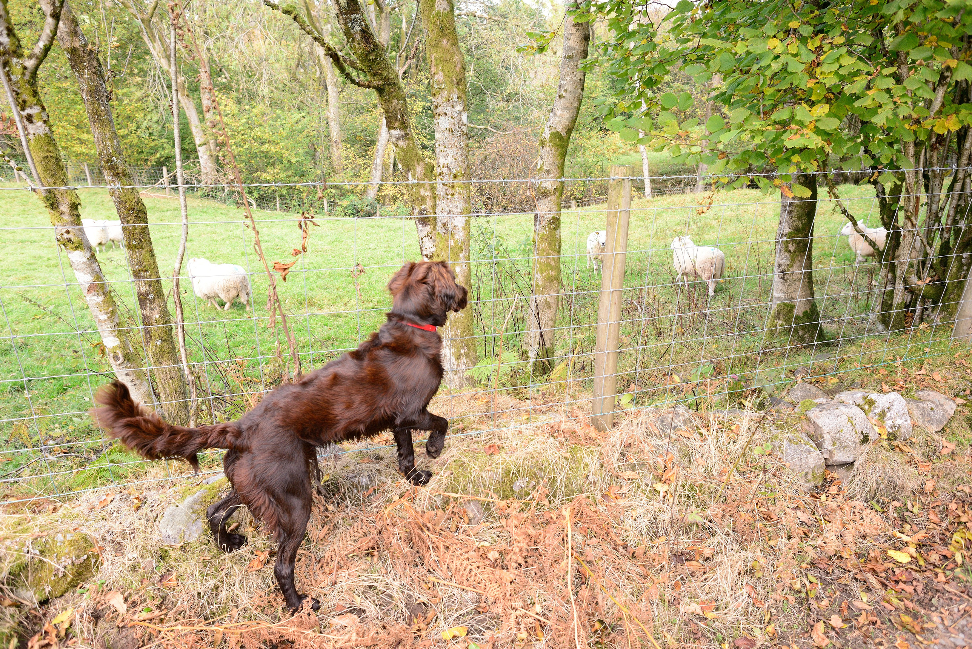

Have you ever had your own dog involved in a sheep worrying attack?
No - 1,798
Yes - 235
I’m not sure - 12
Notes:
Out of the respondents, 1,798 people reported that their dogs have never been involved in a sheep worrying attack. This is reassuring but also highlights that the issue might be less visible to many dog owners.
On the other hand, 235 respondents have faced the distressing experience of their dog being involved in such an incident. This statistic is crucial because it demonstrates that sheep worrying is not just a hypothetical risk, but a real event that affects dog owners, farmers, and livestock.
There are also 12 respondents who were unsure if their dogs were involved. This uncertainty points to a need for greater awareness and understanding of what sheep worrying involves and how it can happen.
It’s important to note that the presence of uncertainty among some dog owners suggests there could be more cases that simply go unrecognized or unreported.

Slide 11
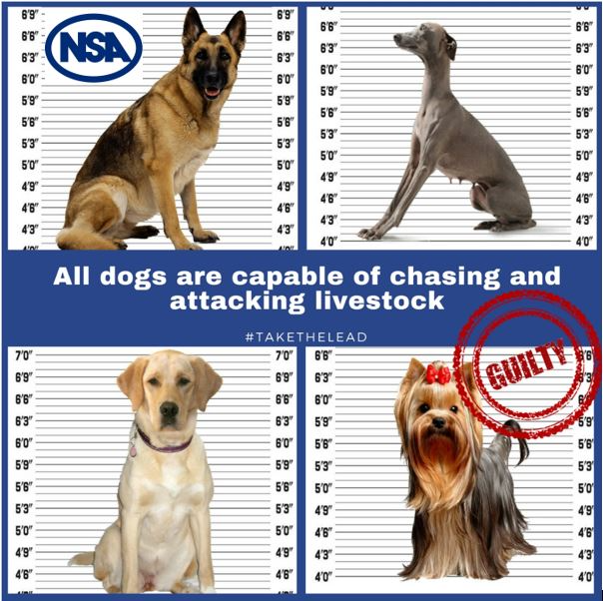
Any correlation between breeds and worrying?
Survey data showed there were 235 reports from dog owners who indicated their dogs had been involved in a sheep worrying attack.
The breeds reported were highly diverse, ranging from traditional working and herding dogs to common companion breeds.
This highlights the message that any dog is capable of sheep worrying.
Notes:
Our survey revealed some interesting findings regarding the breeds involved in sheep worrying incidents. There were 235 reports from dog owners, and the breeds mentioned varied widely. This included everything from traditional working and herding dogs to popular companion breeds.
The key takeaway here is that any dog, regardless of breed, is capable of sheep worrying. This challenges common assumptions and highlights the need for vigilance from all dog owners, regardless of the type of dog they own.
Understanding that no dog is exempt from this behavior is crucial for preventing future incidents.
All dogs have the instinct the chase...
Let's ensure we are all proactive in managing our pets responsibly.

Slide 12
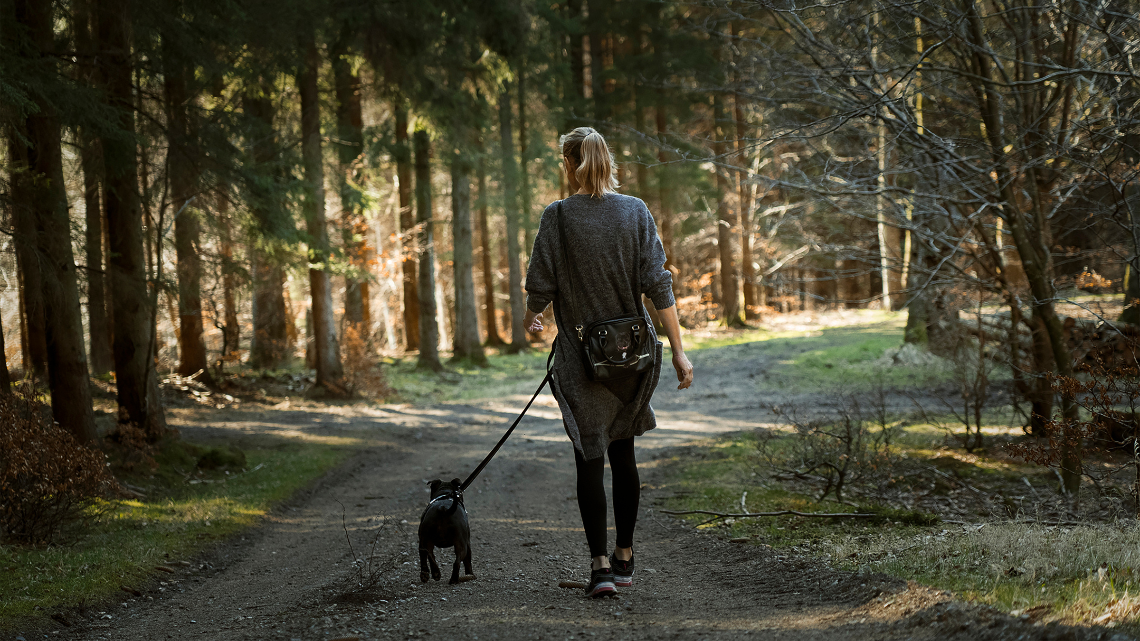
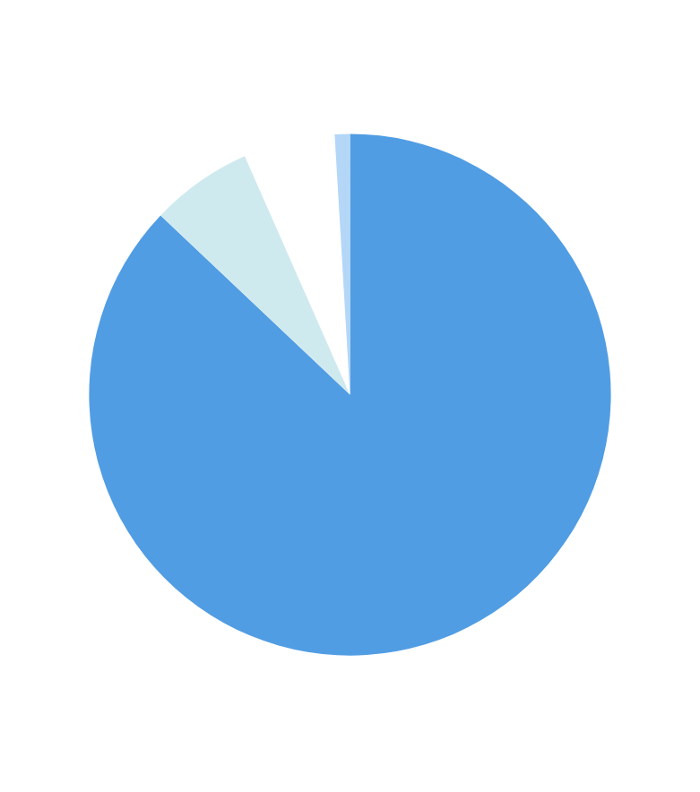
If you saw sheep ahead on a dog walk, would you:
Put your dog on a lead - 1,582
Call your dog back but leave off lead - 115
Choose another route - 103
Continue as normal - 17
Notes:
When confronted with sheep during a dog walk, people's responses vary significantly.
The majority, over 1,500 individuals, would responsibly put their dog on a lead. This is a commendable choice minimizing risk to both the sheep and the dog.
Interestingly, a smaller number—115—would call their dog back but not put it on a lead. While this demonstrates awareness, it still leaves room for potential incidents.
Then, we have 103 individuals opting to take a different route altogether, a proactive approach to avoid any confrontation. This is another effective strategy for ensuring safety.
There were still a small number of respondents that would continue as normal without altering their behavior. This choice highlights the need for increased awareness and education on the risks involved.
Other responses included:
- a combination of these
- stating their dogs had been through livestock aversion training so no specific response needed
- and some had a difference response depending on which dog they were walking.

Slide 13
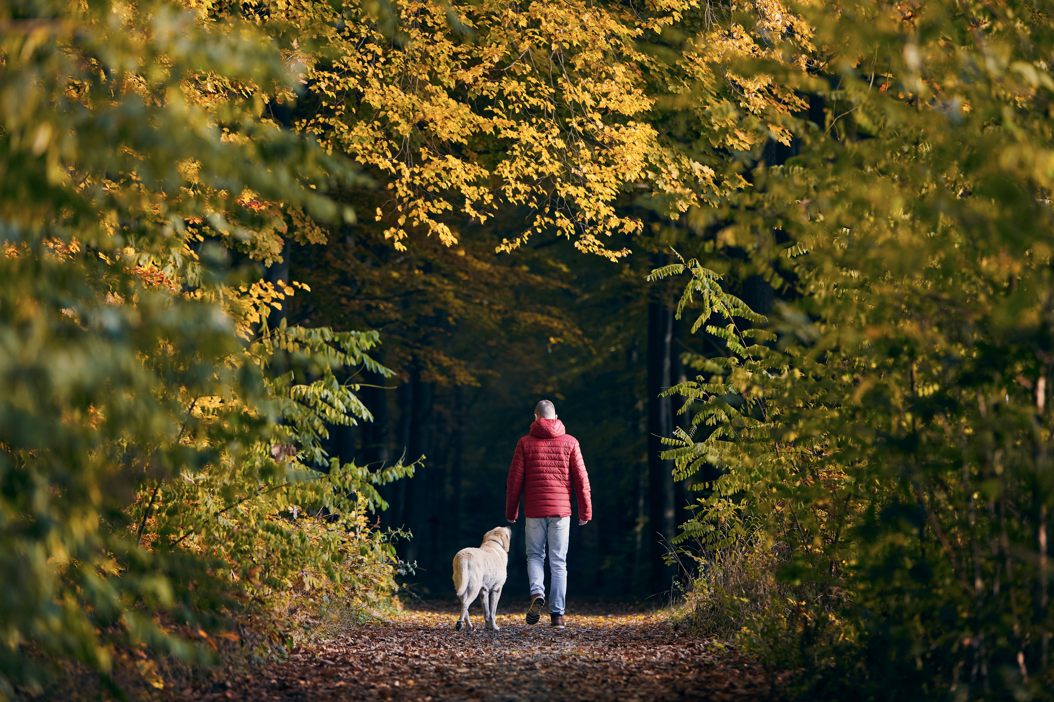
Sheep worrying is widely recognised but not fully understood.
While 97% say they know what it is, only 65% realise dogs off lead near sheep counts as sheep worrying.
But there is an understanding of sheep worrying being more than a physical attack.
“Dog-induced stress and disturbance, not just physical harm.”
Notes:
While a significant 97% of people claim they know what sheep worrying is, only 65% of them actually understand that letting dogs off the lead near sheep qualifies.
This suggests a critical gap in awareness about what constitutes sheep worrying.
What was reassuring is the recognition from repondents that sheep worrying includes barking, chasing and the prescence of a dog near sheep are sheep worrying.
- and extends beyond a physical attack.
It includes the stress and disturbance dogs can cause to sheep, even without direct contact.
This broader definition underscores the need for clearer communication and education on this issue.
Recognizing these nuances in sheep worrying helps us better protect livestock and foster responsible pet ownership.

Slide 14

What dog behaviours do you think can be considered sheep worrying? (Tick all that apply)
Notes:
Respondents recognised behaviors such as chasing, barking, or even a dog simply running around sheep as worrying - all leading to stress and disruption for the sheep.
It’s not only about aggression. Even seemingly playful actions can cause significant distress to sheep, impacting their welfare
By broadening our understanding of these behaviors, we can take more informed steps towards preventing sheep worrying.

Slide 15
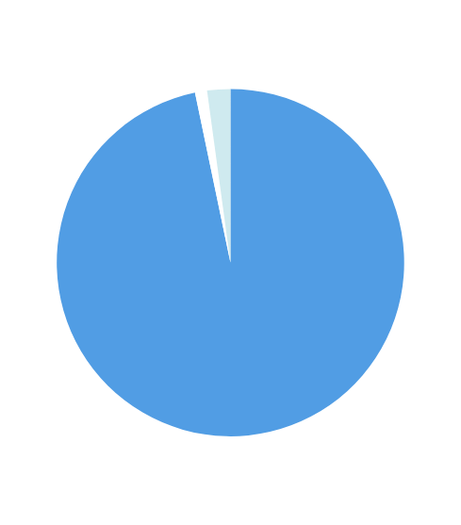

Many public definitions focus on stress and disturbance, not just a physical attack.
These are some of the most common words that came up in responses:
Do you know what the term “sheep worrying” means?
Yes - 96.7%
No - 1.1% (23 responders)
Unsure - 2.2% (44 responders)
Notes:
In our survey, we asked participants if they knew what "sheep worrying" means. A reassuring 96.7% said yes, showing a high level of awareness. However, a small percentage unaware/unsure, indicating there's still room for education and clarity.
The words most frequently associated with sheep worrying were stress, disturbance, and concern. This tells us that people recognize the broader impact beyond just physical harm.
Let's work towards reducing these numbers of uncertainty and ensure everyone understands the seriousness of the problem.

Slide 16
“Under control” is a grey area putting sheep at risk.
Almost half of owners let dogs off lead on common land (44%), many relying on recall rather than physical restraint.
There seems to be a different perspective to risks of livestock prescence on farmland than on common land.
Only 31% let their dogs off lead on farmland.
Notes:
Almost half of dog owners, about 44%, allow their dogs off-lead on common land. This reliance on recall rather than physical restraint can be risky.
Interestingly, the numbers drop when it comes to farmland, with only 31% of owners letting their dogs roam freely. This suggests a different perception of risk in these areas.
I'd be concerned that we might see an increase in the the use of technologies such as virtual fencing, where livestock are contained in an area using a virtual fence. This posses an increased risk for dog owners/walkers as going forward, the 'back-up' of a physical fence between a dog off lead and livestock could become less common - and these will occur more on common land.
The term "under control" often seems ambiguous, creating a grey area that can endanger sheep. It's crucial that we clarify what "under control" truly means to ensure the safety of all animals involved.

Slide 17
Awareness of penalties is high - but gaps remain.
Dog owners know the immediate risks of sheep worrying - but most are unaware they could face prison or a lifetime ban on keeping dogs.
The majority understood there were fines associated with sheep worrying (92%), their dog could be shot if caught in the act (94%), compensation (85%), dog seizure (77%) or euthanized (71%), but less understood about imprisonment (34%) and being stopped from keeping dogs (32%).
Notes:
Let's have a look at the legal implications of sheep worrying that dog owners might not fully comprehend.
Many dog owners are aware of the severe consequences their pets could face, such as fines, the possibility of their dog being shot if caught, or even having to pay compensation. However, there's a significant gap in awareness regarding the risk to them directly.

Slide 18

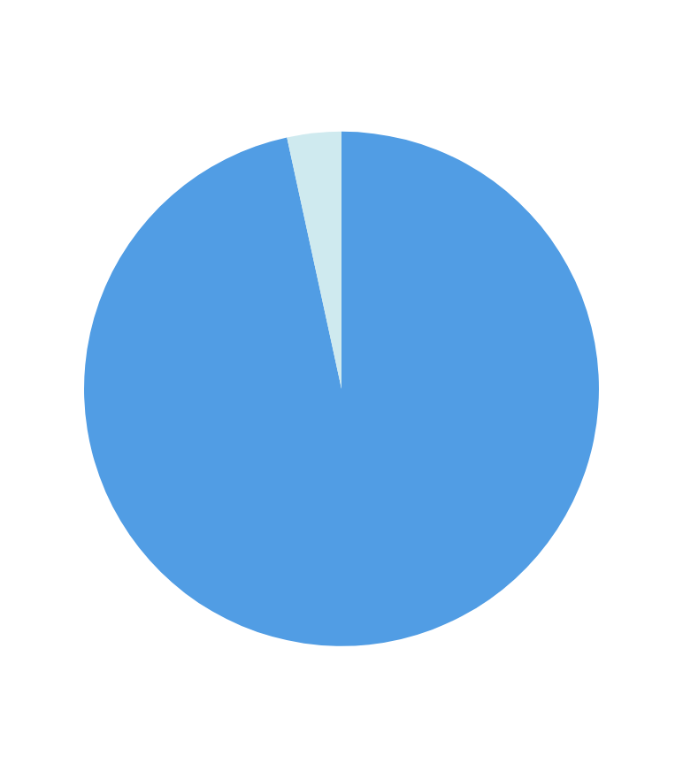
Are you aware that sheep worrying is a crime?
Yes - 1,975
No - 70
Notes:
The data reveals a significant level of awareness about the crime of sheep worrying. Out of those surveyed, a substantial majority, 1,975 individuals, are aware that sheep worrying is indeed a criminal offense, while only a small fraction, 70 respondents, are not aware.
This shows that the message about sheep worrying as a crime is reaching most of the dog-owning community. However, it's crucial to address those individuals who aren't aware, as their lack of knowledge could lead to unintentional law-breaking.

Slide 19
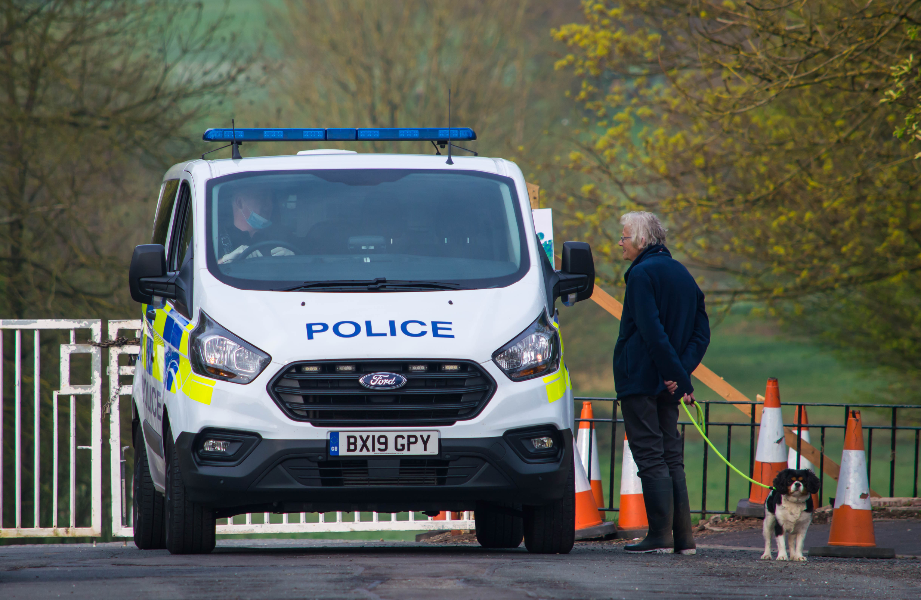

What do you think are the consequences of sheep worrying? Tick all that apply
Notes:
While awareness is high, it's important to ensure that everyone understands not only that sheep worrying is illegal but also the severe consequences that can follow.
A staggering 94% of owners know their dog could be shot, yet only 34% understand they could face jail time. Similarly, while 85% know about compensation and 77% about dog seizure, just 32% realize they could be prohibited from having dogs for life.
This lack of knowledge about the harsher penalties highlights a critical area for increased education and awareness.
With the enactment of The Dogs (Protection of Livestock) (Amendment) Act 2025, which came into effect on 18th March 2026, the law has changed, meaning awareness and understanding of the risks to both dog and dog walker might be even less than the statistics captured here.

Slide 20
Prevention and messaging
Signage works and the public want more of it.
72% say more signage would or might encourage responsible behaviour. But highlighted the need to remove signage when livestock are not present to reduce complacency and message fatigue.
Visibility and clarity are critical.
Clear, visible warnings from farmers are the top-requested action.
78% support better signage, alongside well-maintained fences and gates.
Notes:
[HAND OVER TO KATIE HERE]

Slide 21
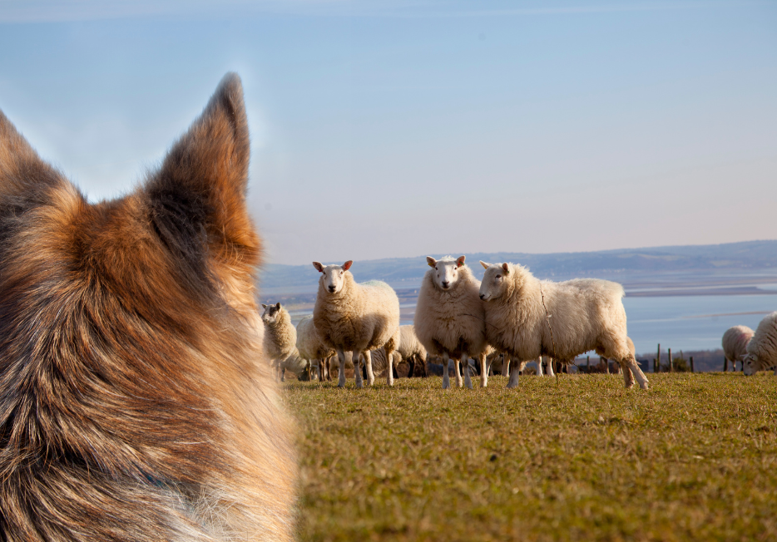
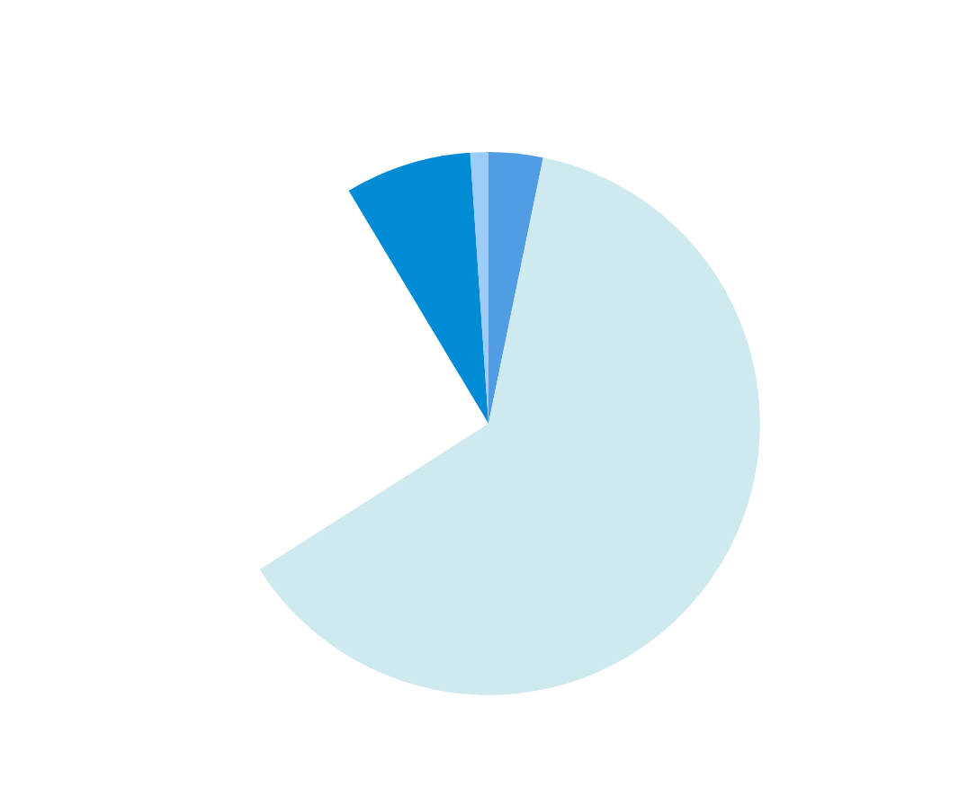
Have you ever seen signs advising dog walkers to keep dogs on a lead near sheep?
Yes, often - 1,283 (62.7%)
Occasionally - 520 (25.4%)
Rarely - 154 (7.5%)
Never - 66 (3.2%)
Yes, but there aren’t sheep in the field - 22 (1.1%)

Slide 22
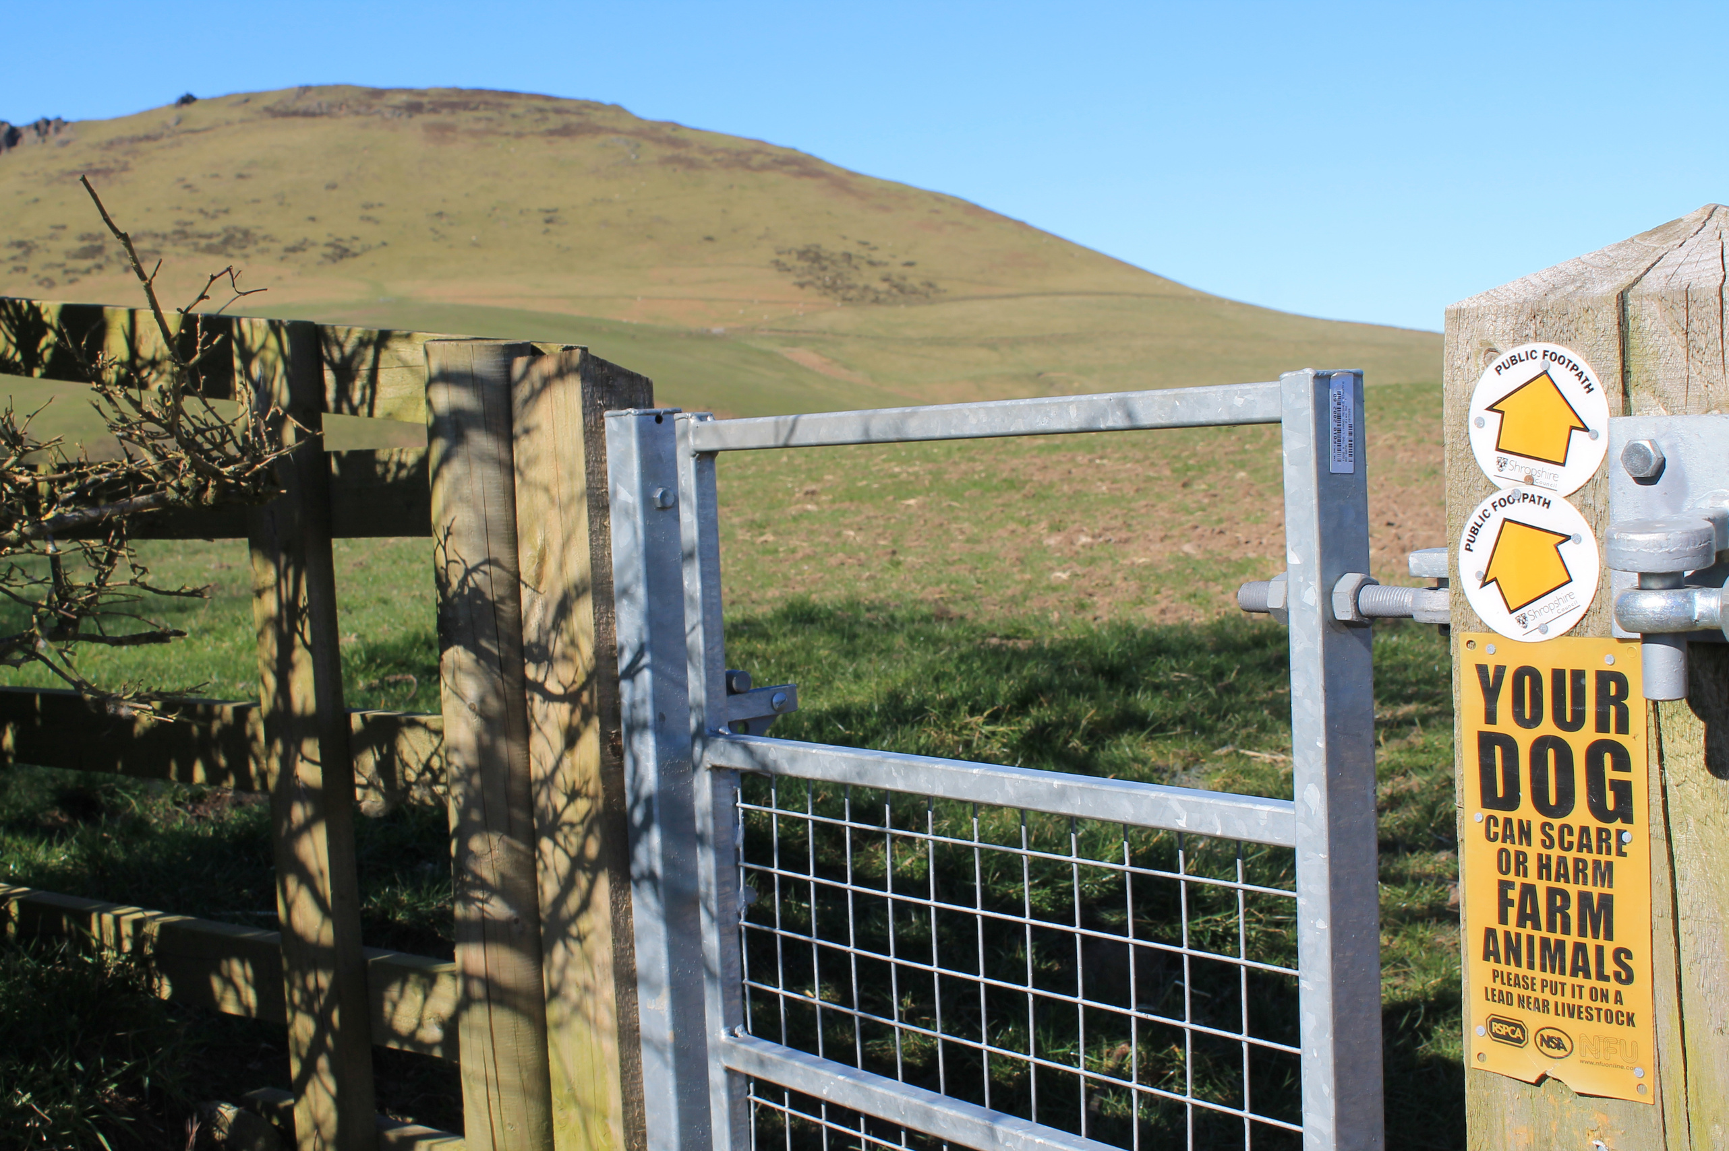

Would more signage or public awareness campaigns encourage you to keep your dog on a lead around sheep?
Yes - 1,104
No - 572
Maybe - 369

Slide 23
Education must drive behaviour change
Education must go beyond awareness to behaviour change.
Training, campaigns and signage all seen as essential by the public.
Awareness alone is not enough.

Slide 24
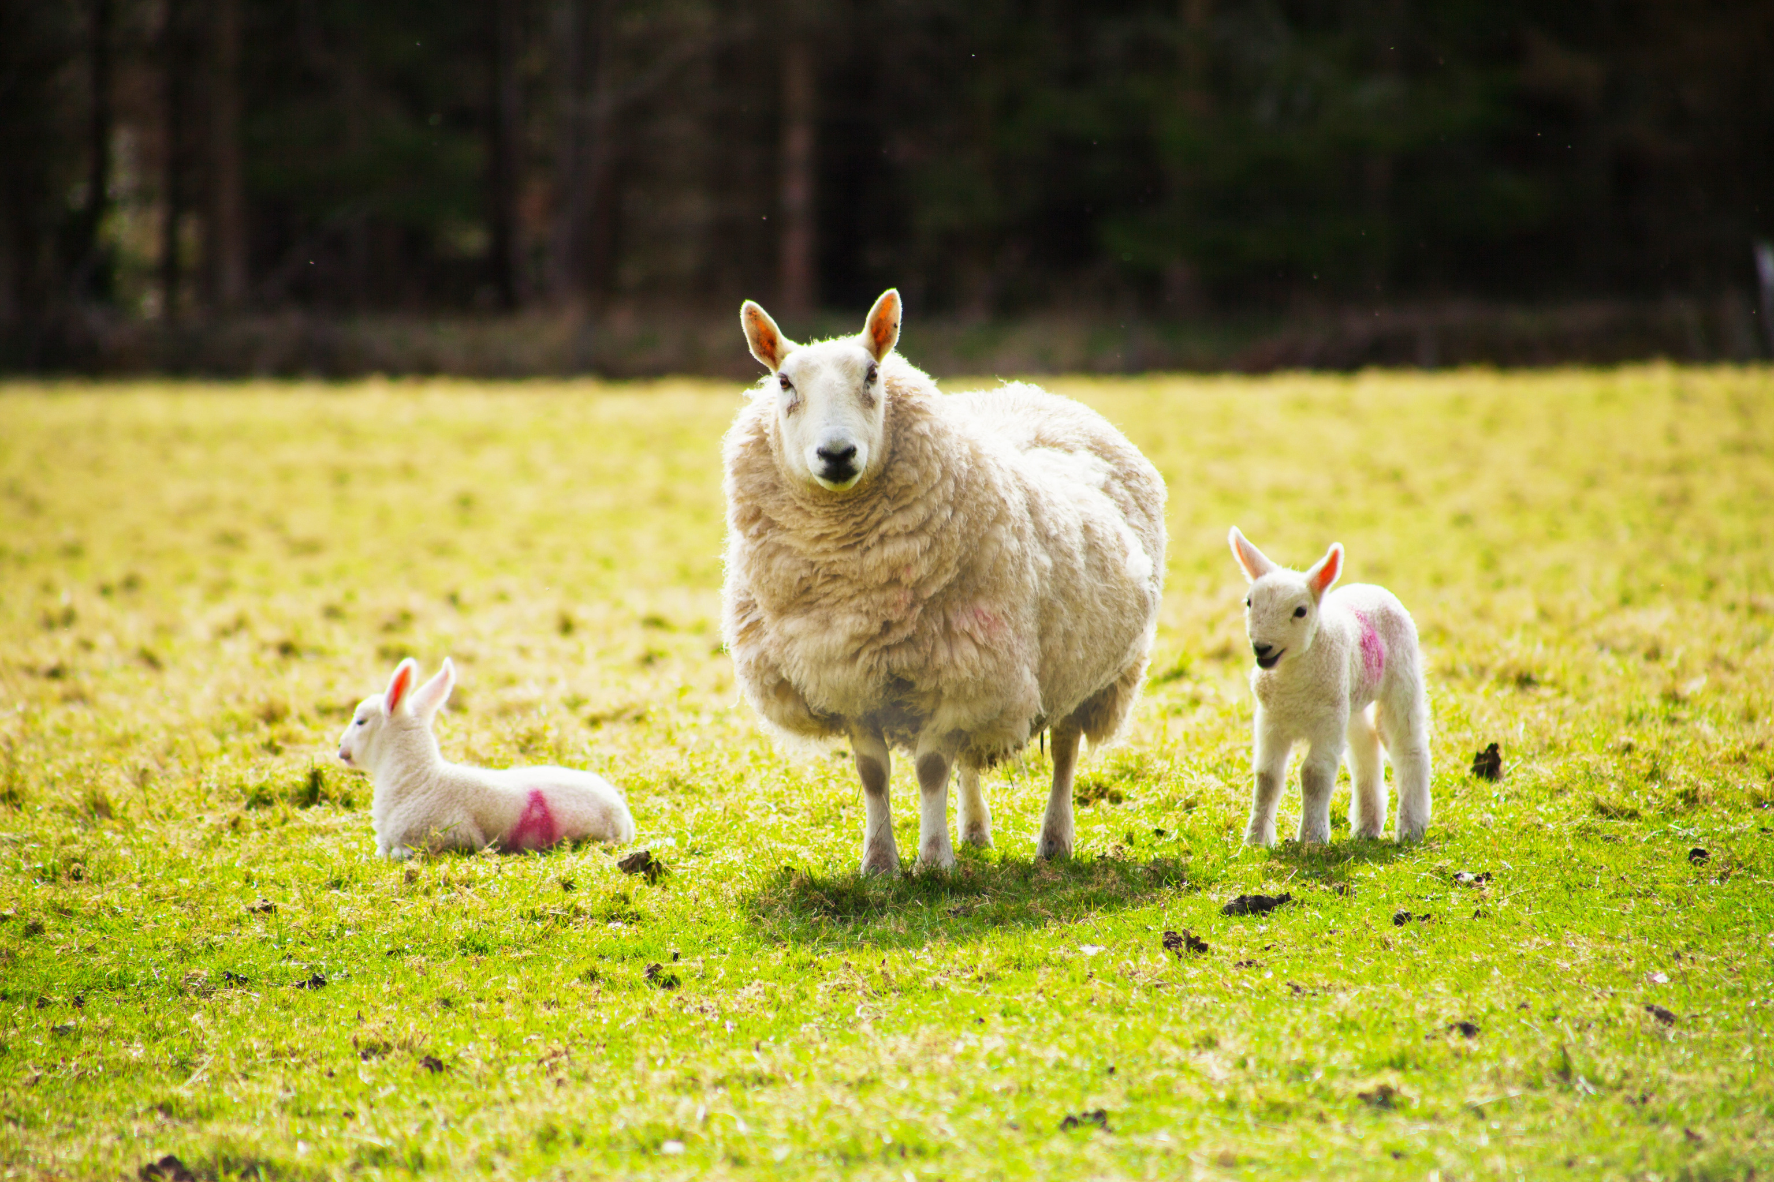

What methods do you think would be most effective in preventing sheep worrying? (Tick all that apply)

Slide 25
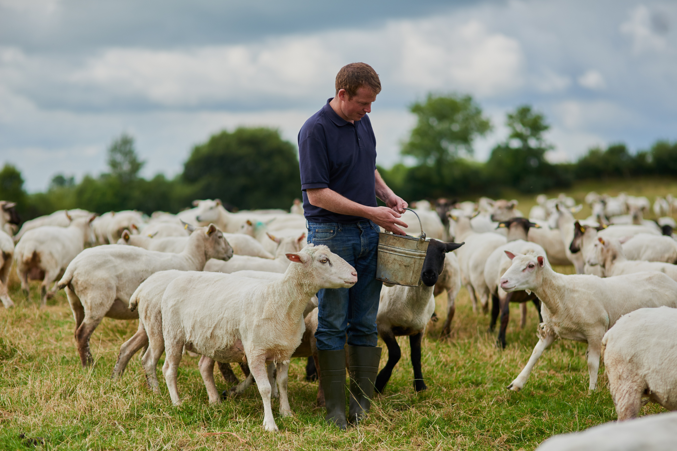

What action from farmers would encourage you to keep your dog on a lead around sheep and prevent your dog accidently getting into fields with sheep?

Slide 26
Our key takeaways
Collaboration is essential.
General feeling that responsibility is shared - but it starts with dog owners.
There is a strong consensus that owners must take full accountability for their dogs behaviour.
Better communication between farmers and dog walkers is key.
Support for clearer information about livestock presence and risks in specific areas to help dog walkers make informed decisions.
Constructive engagement matters.
Most interactions with farmers are neutral or positive, offering a strong foundation to build better collaboration.
Notes:
Our key takeaways from the discussion highlight several important points in tackling sheep worrying effectively.
First, collaboration stands out as crucial. Although responsibility is shared among all parties, it fundamentally begins with dog owners. There's a strong consensus that owners must take full accountability for their dogs' behavior.
Better communication is another critical factor. Open dialogue between farmers and dog walkers is key to fostering understanding. Support for providing clearer information about livestock presence and risks in specific areas can empower dog walkers to make informed decisions.
Lastly, constructive engagement is vital. Most interactions with farmers are neutral or positive, which provides a solid foundation for enhancing collaboration. By building on these positive interactions, we can create a more cooperative environment for everyone involved.

Slide 27
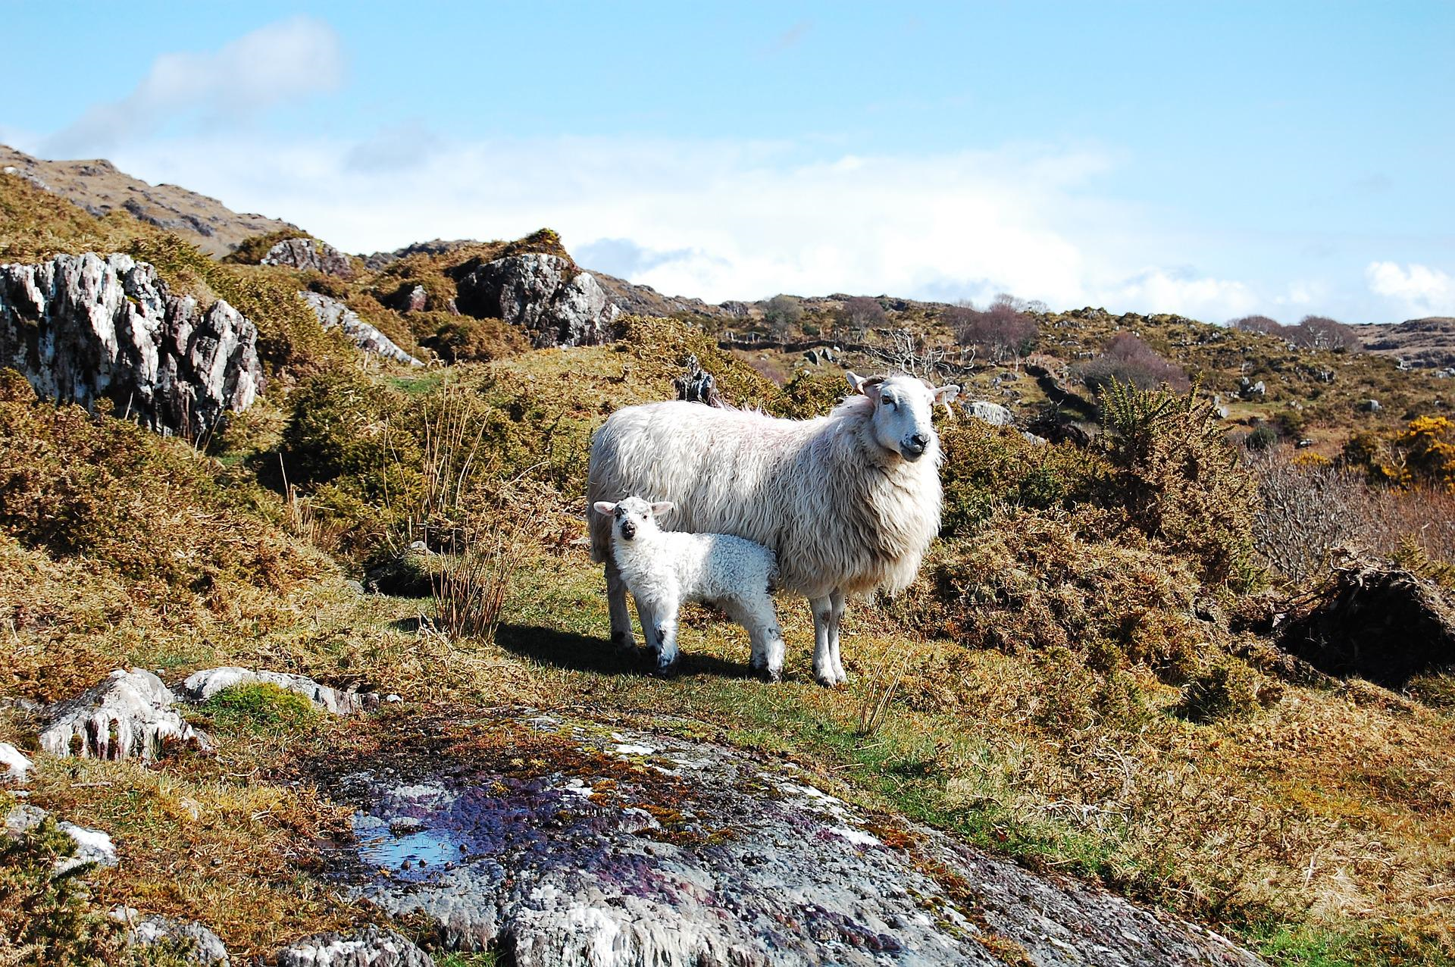
NSA launched a sheep worrying log on its website during the campaign in 2025
Notes:
The NSA has introduced a new online log specifically designed for sheep farmers across the UK. This data is used internally for creating a greater understanding of the of sheep worrying by dogs in the UK.
This data collection is vital for addressing the challenges faced by our farming community.
This does not replace the need to report every incident to the police and this is stressed on the webpage.

Slide 28
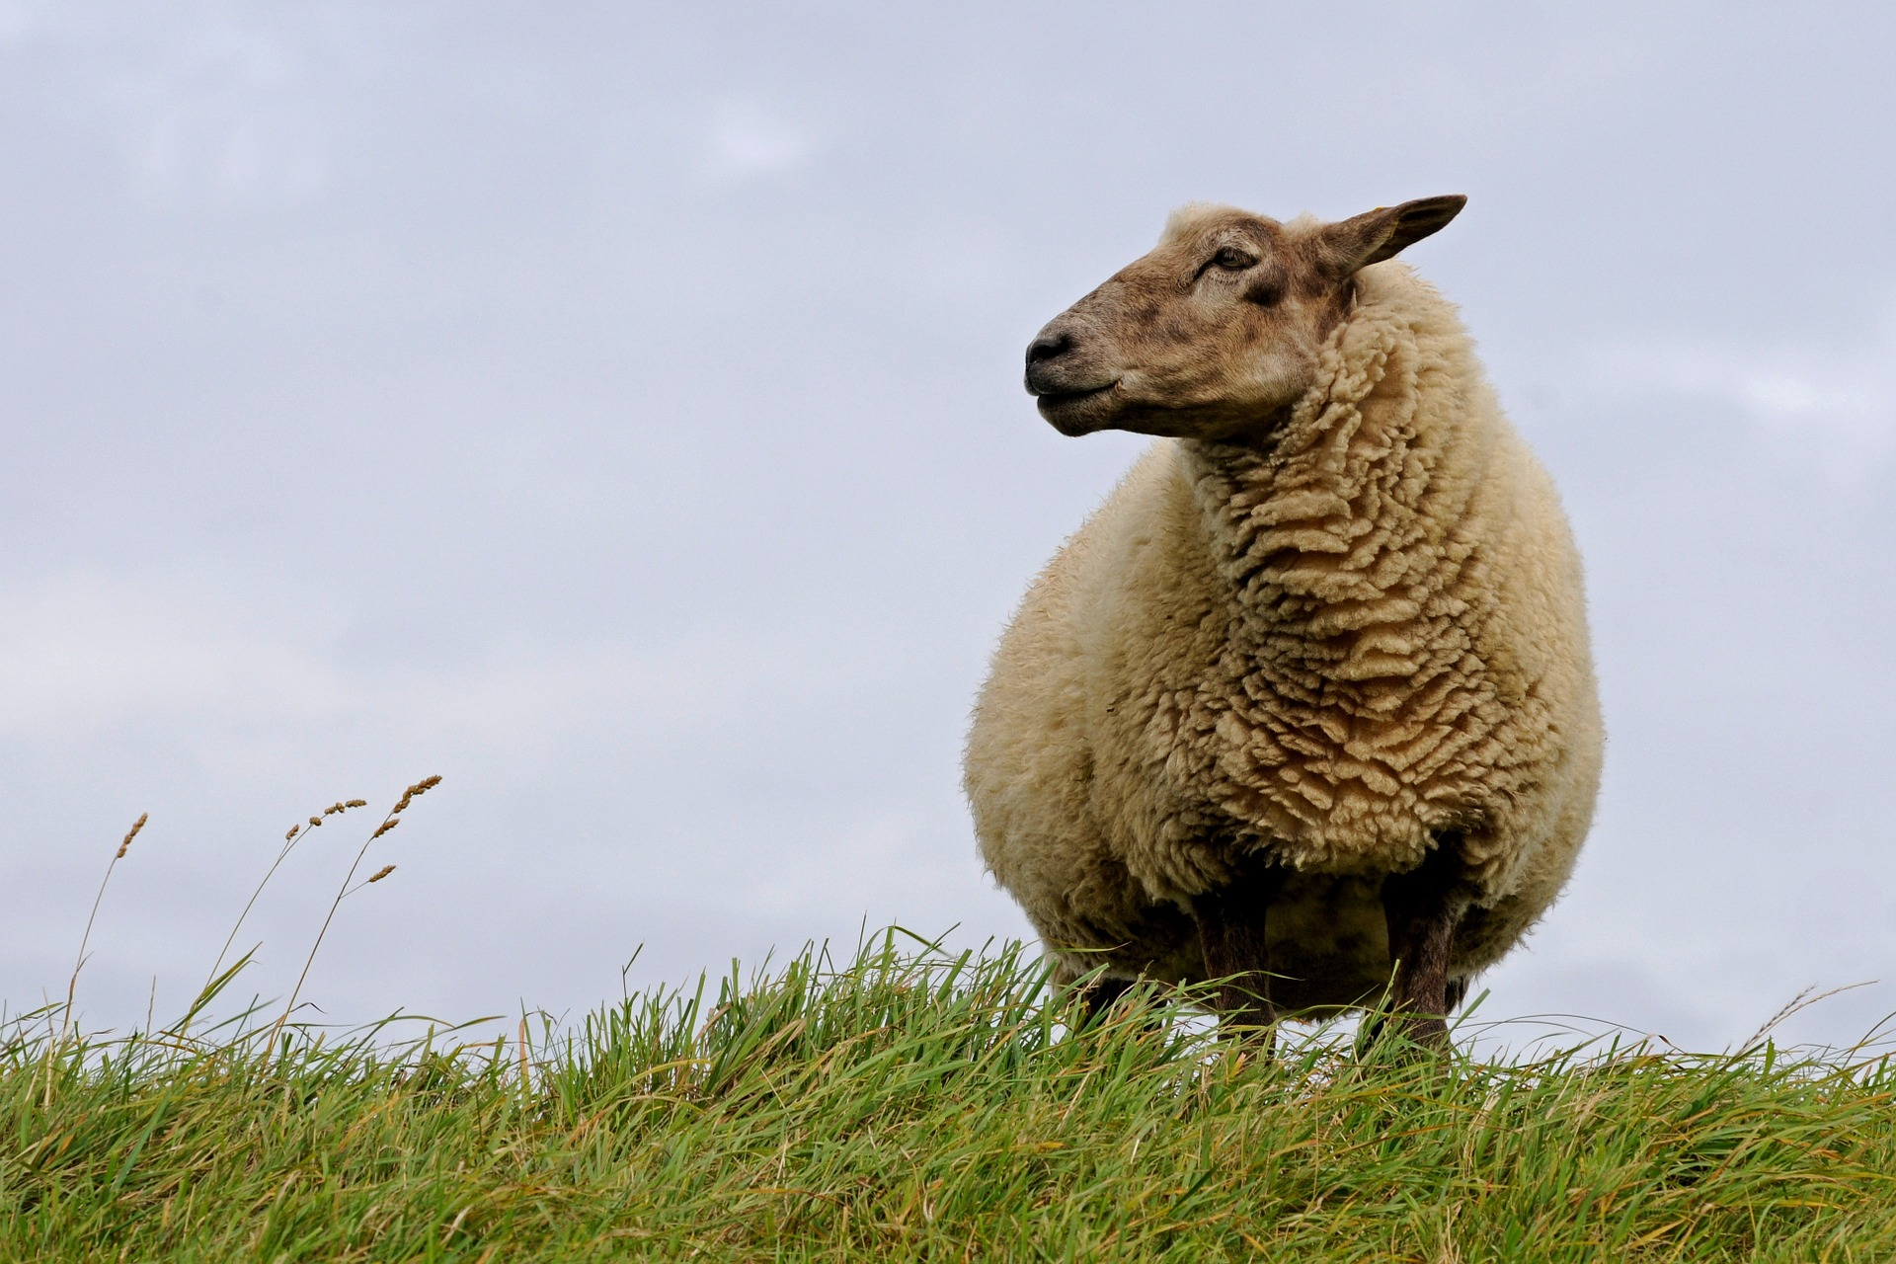
NSA has also introduced a list of dog trainers across the UK that offer livestock avoidance courses.
www.sheepworrying.org.uk
Notes:
In addition we have advice for anyone who has experienced a dog attack on our website.
I encourage everyone to visit the NSA website to explore its resources and support for sheep farmers. Let's work together to enhance the safety of our livestock.

