Slide 1
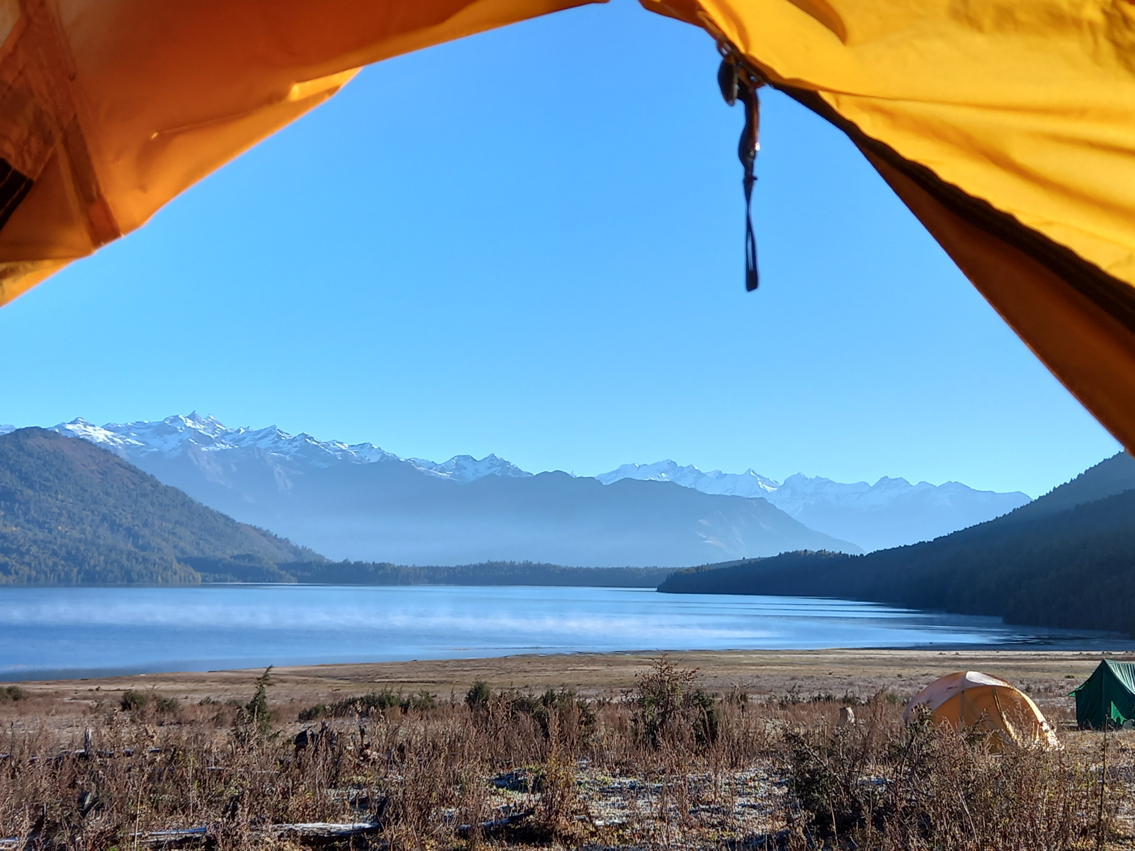
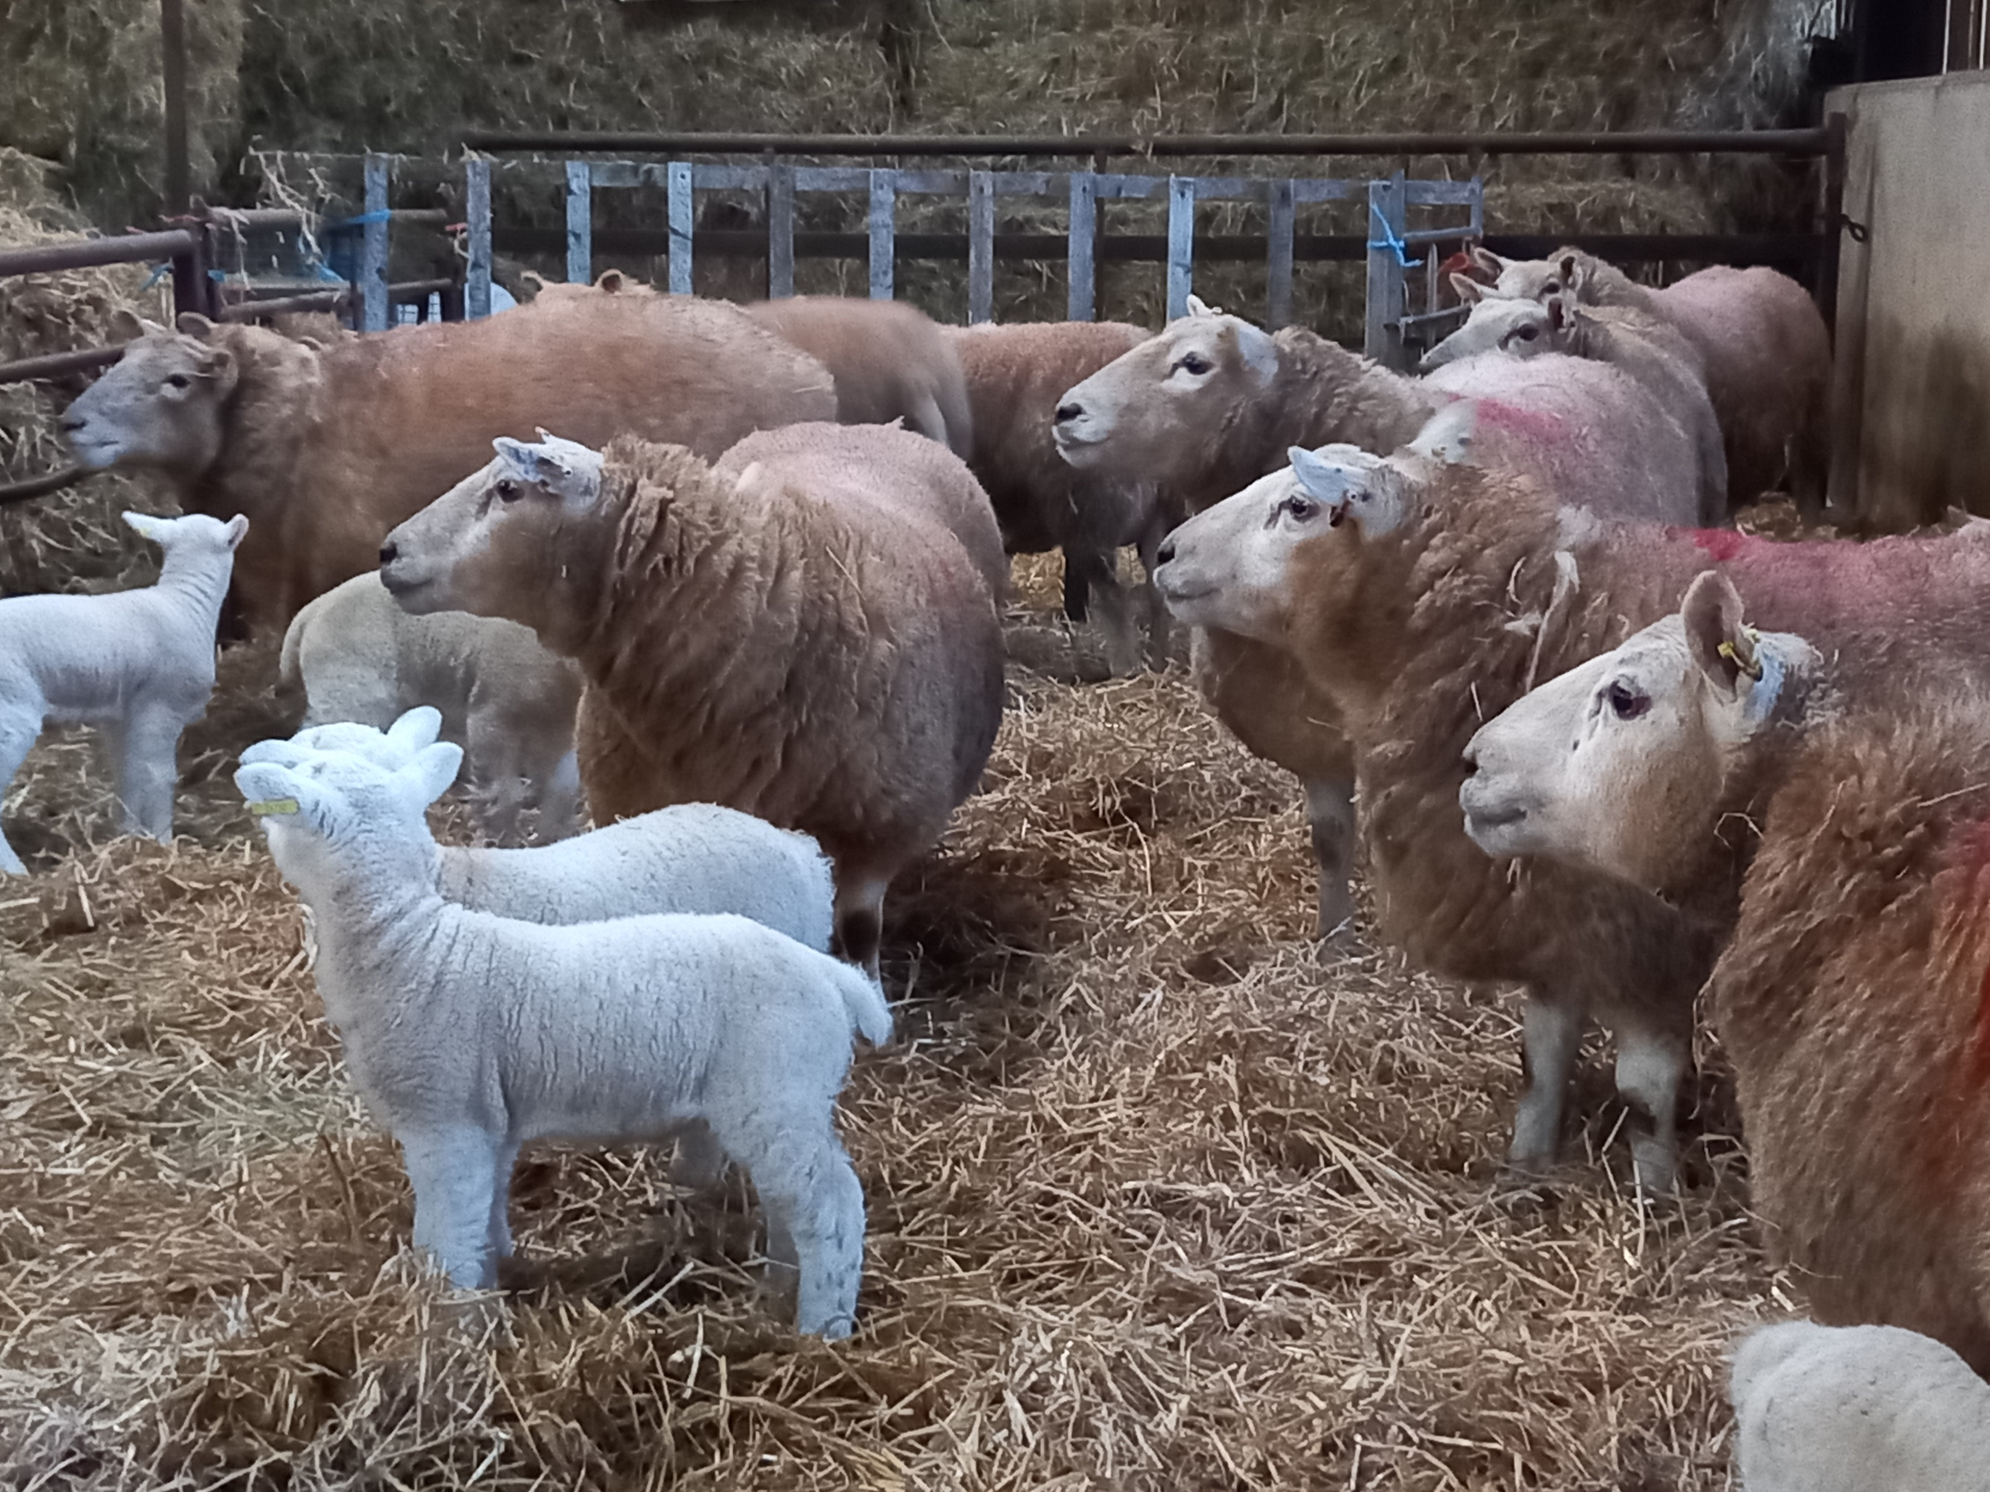
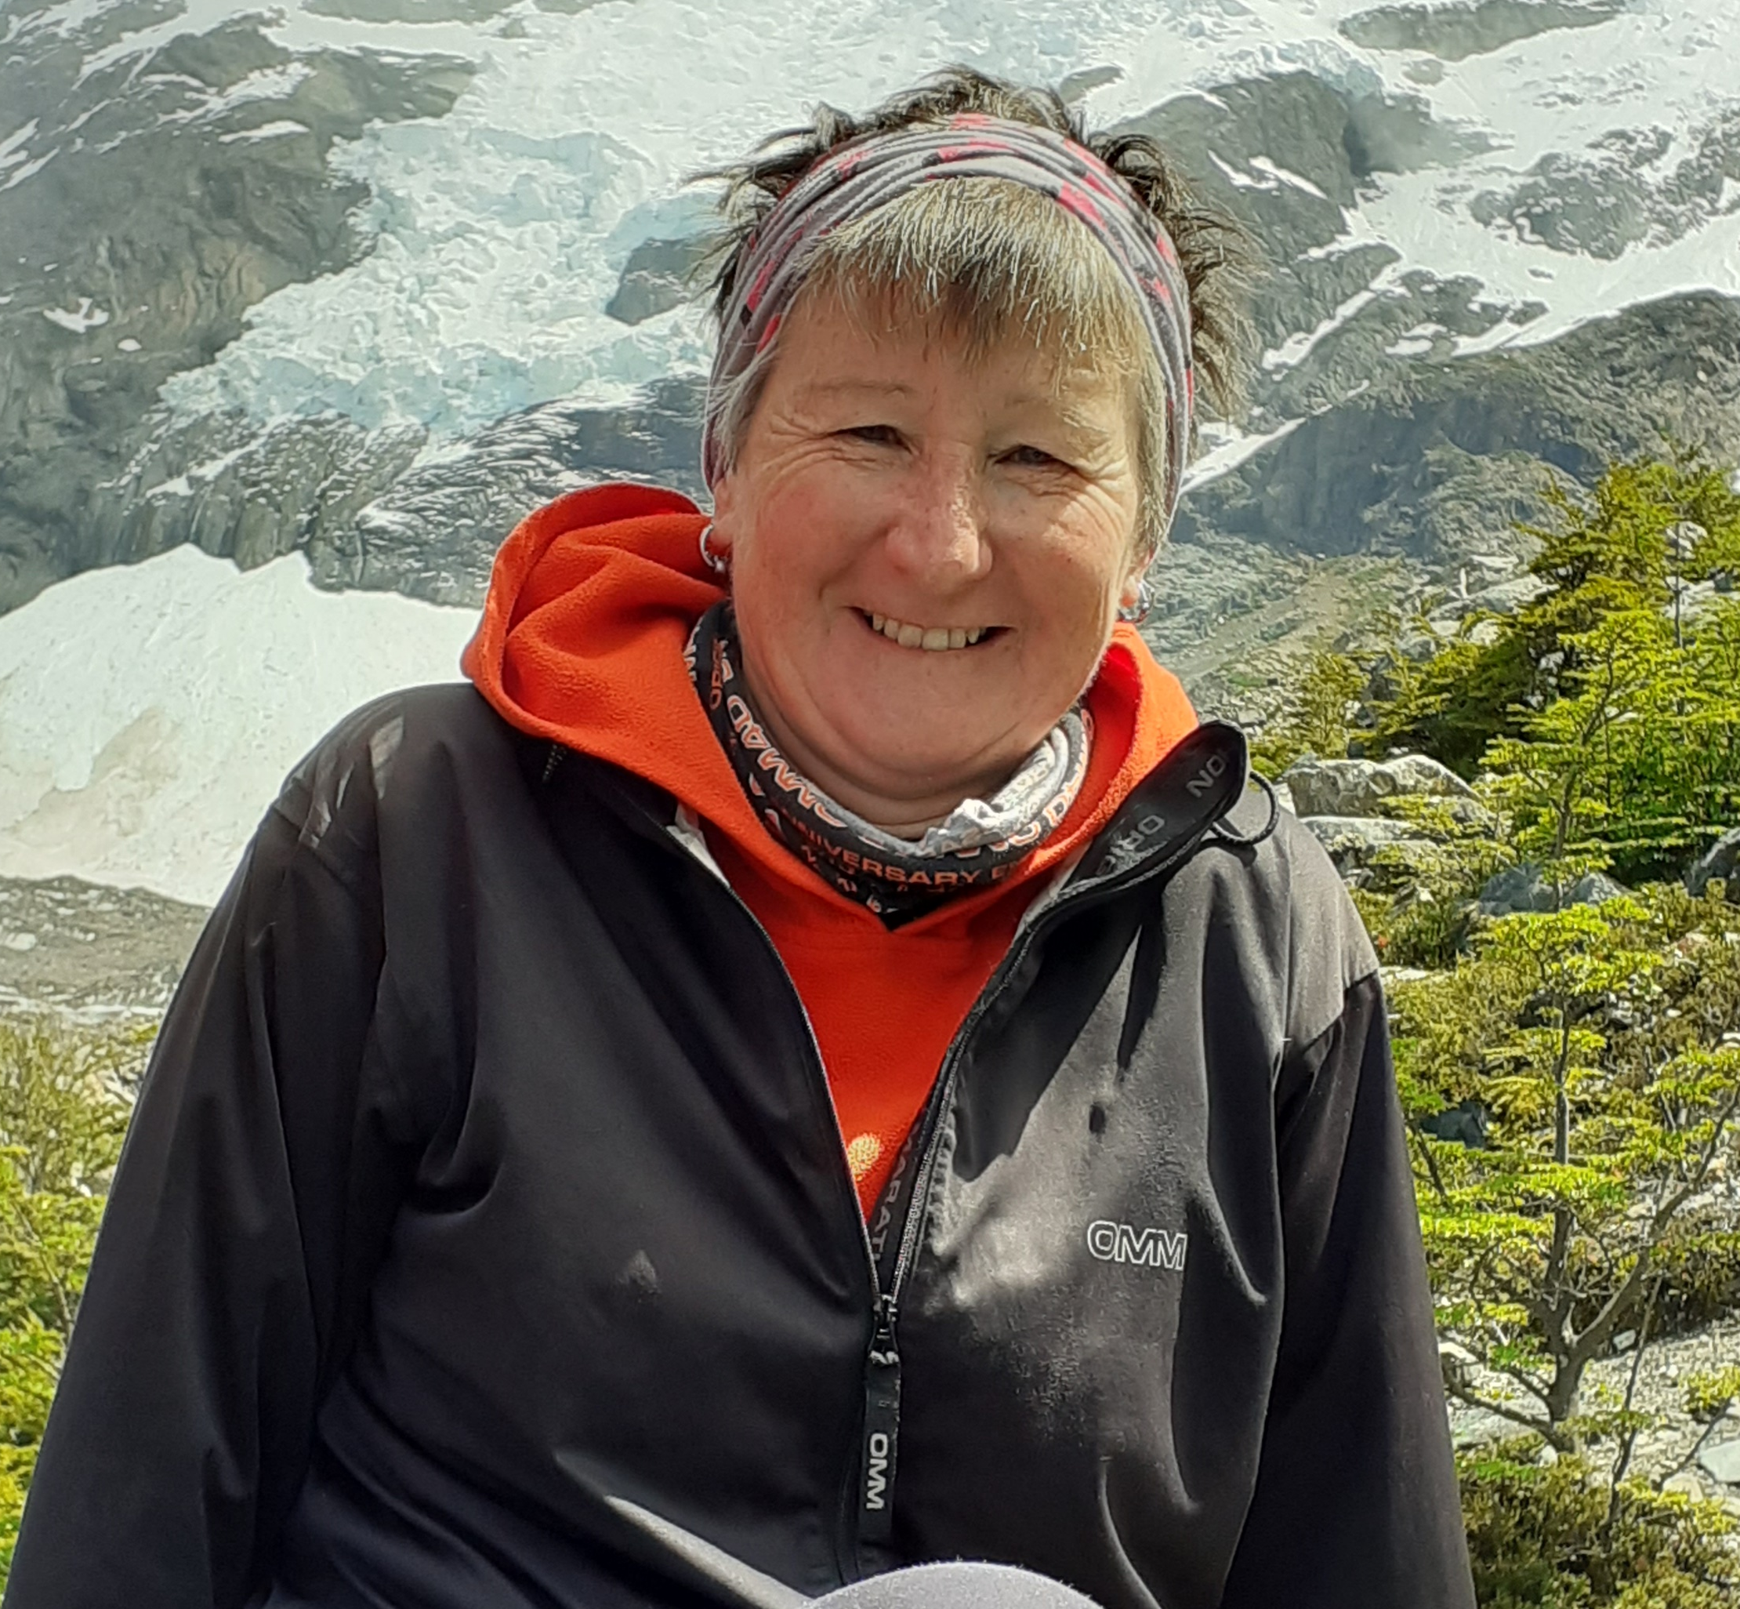
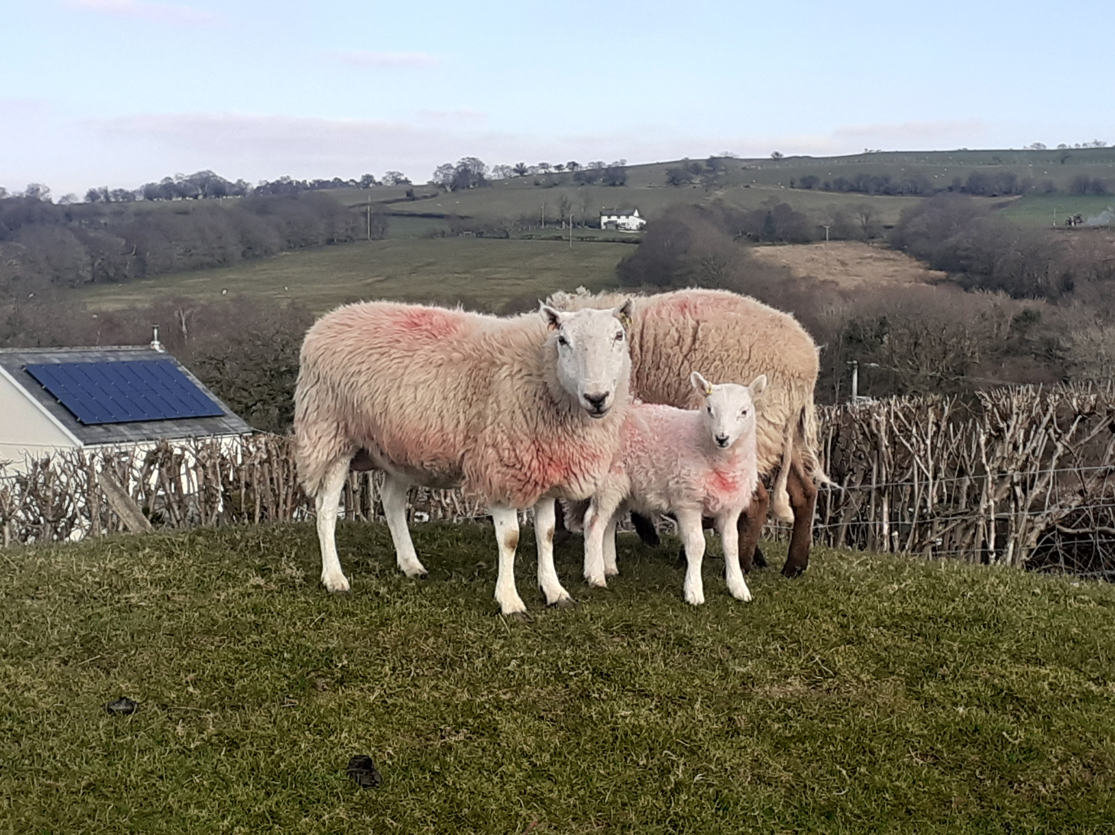
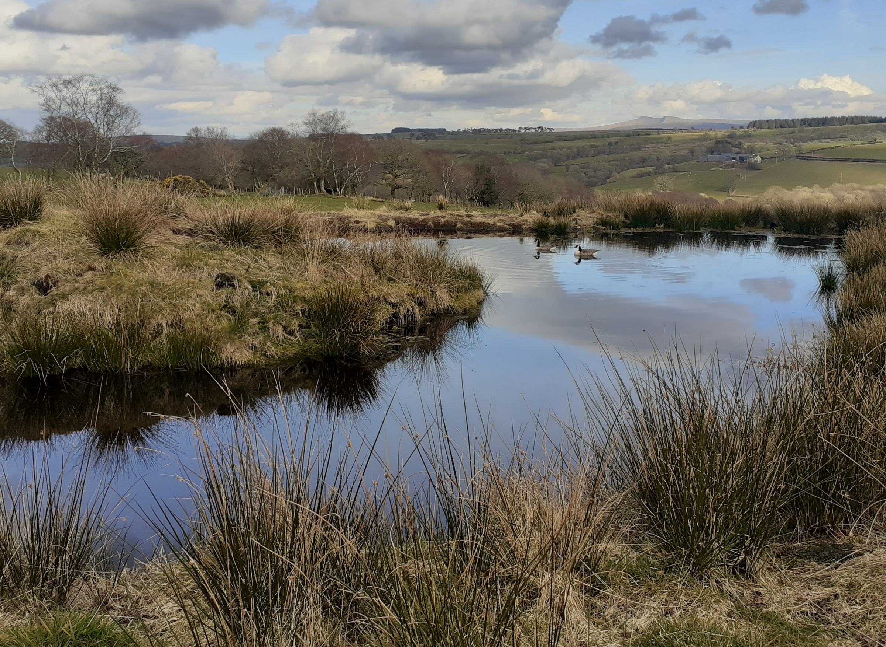
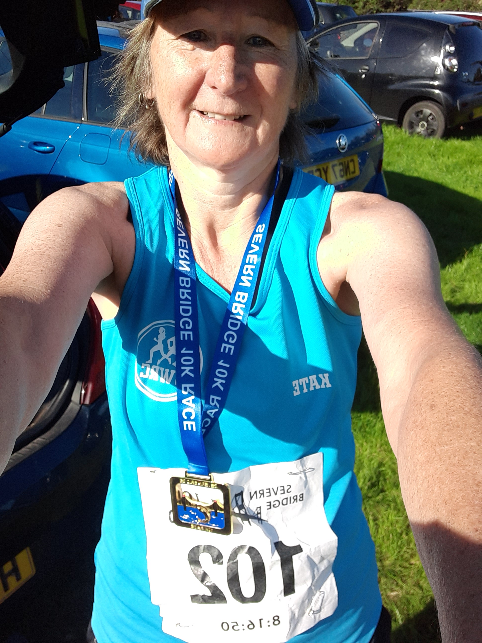
Consultation on Castration and Tail Docking of Sheep

Slide 2
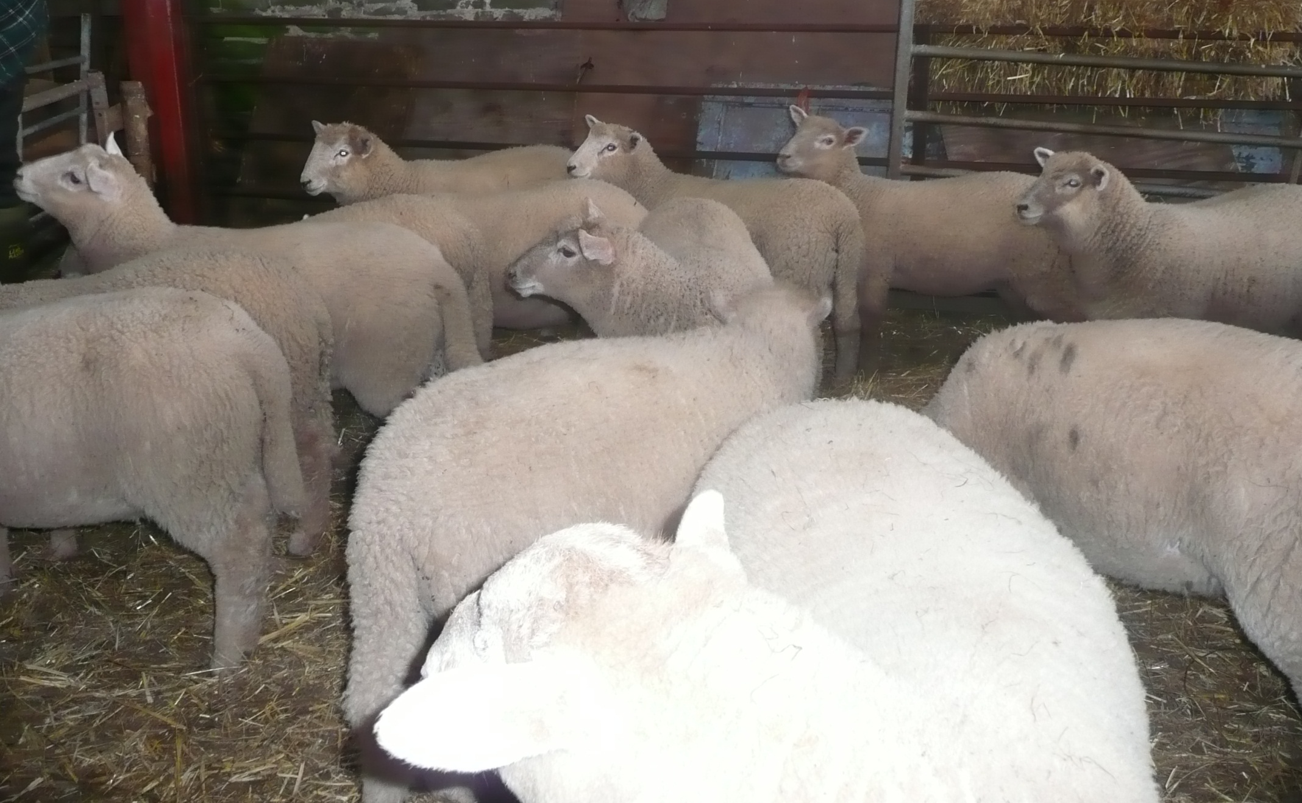
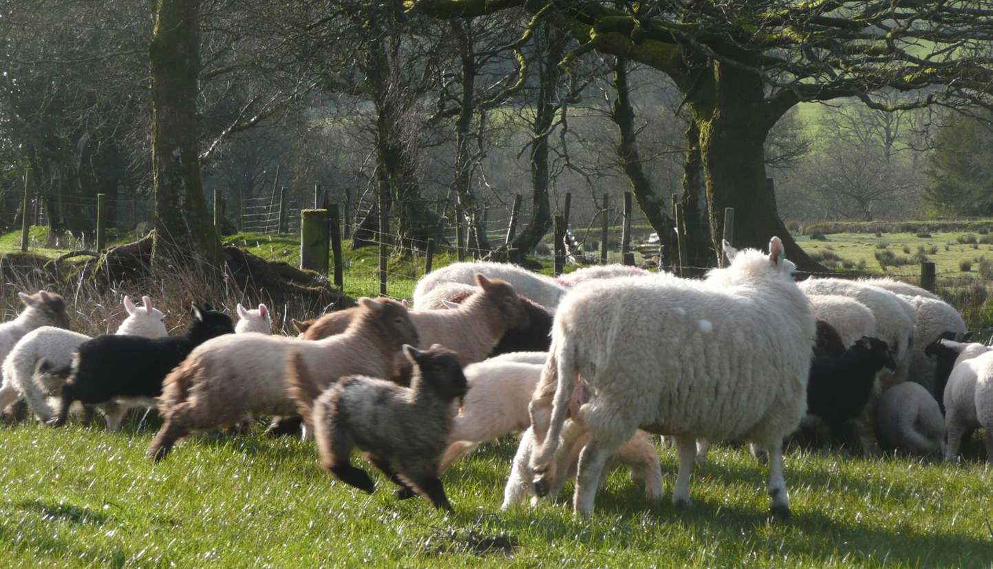
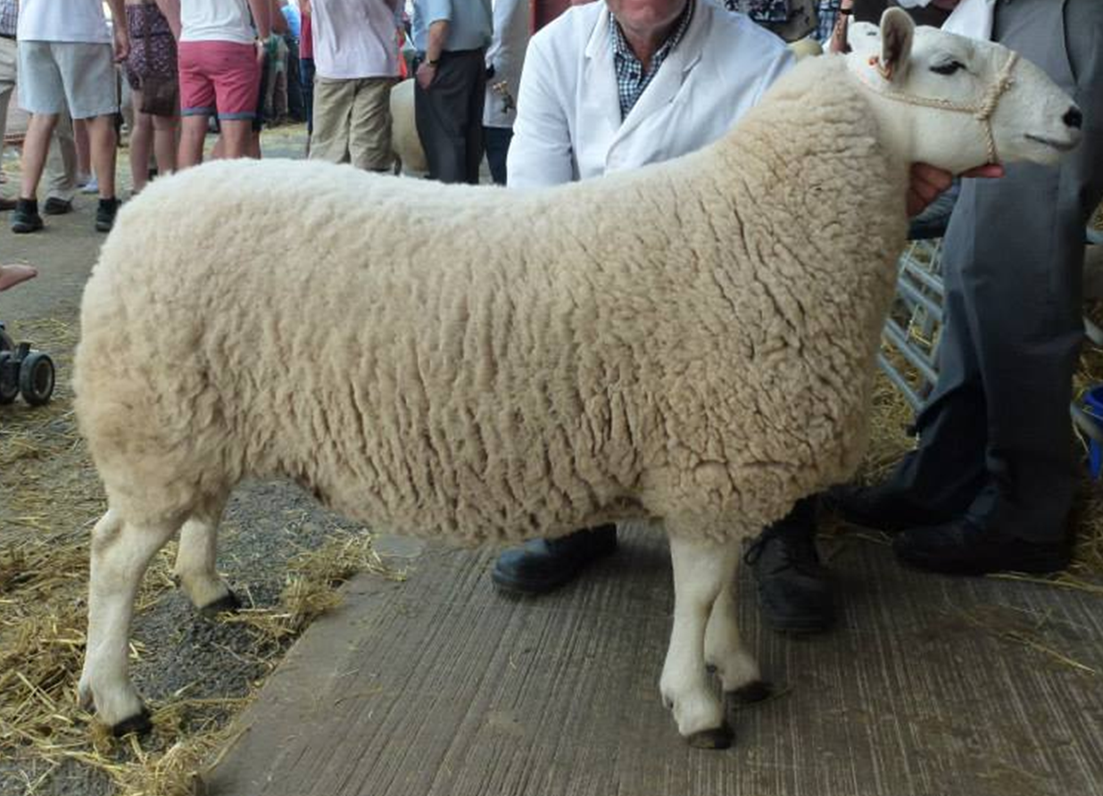
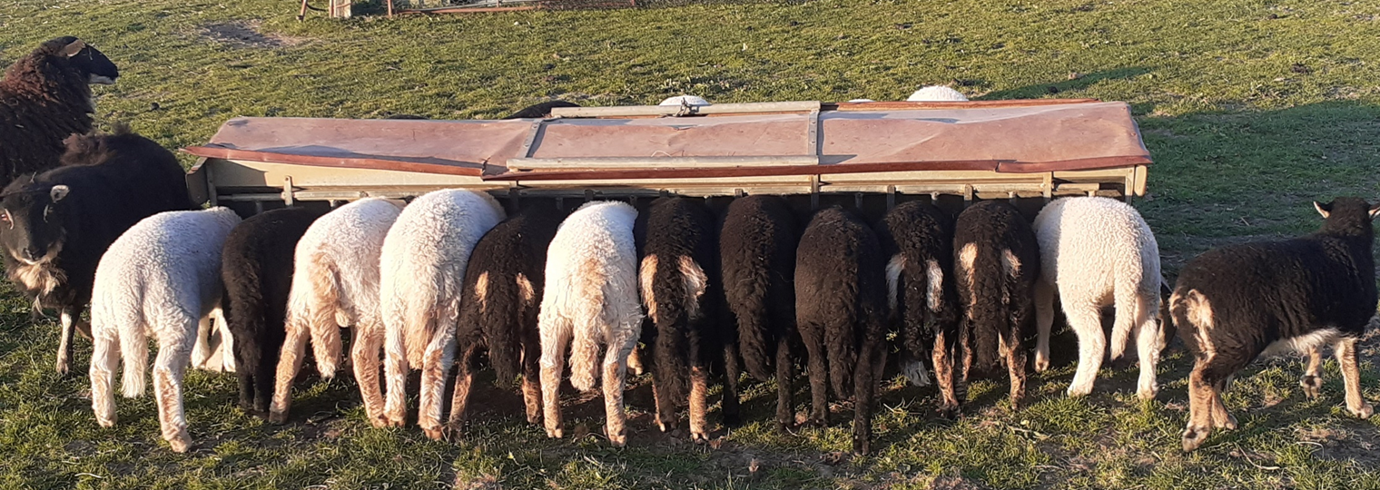
Notes:
We know that these procedures cause short and long term pain. We would like to see pain relief used in all methods of tail docking and castration. However, it is not possible to introduce this without first licensing sufficient appropriate anaesthetic and analgesic products

Slide 3
Small, A., Fisher, A. D., Lee, C., & Colditz, I. Analgesia for sheep in commercial production: where to next? Animals. 2021; 11: 1127.
It is evident from the enormous volume of research underway that the ‘pain and analgesia’ challenge has not been solved for any species, including our own. Therefore, it is unreasonable to expect that we will solve this challenge for the livestock species in the near future, we can merely begin to alleviate pain in order to improve animals’ ability to thrive
…majority of the research into analgesia for livestock species has focused on the acute or immediate pain associated with husbandry procedures. ..there is increasing understanding that post-procedural pain may persist for more than a day or two, and it is likely that chronic or neuropathic pain may also be experienced……. understanding of the physiology and development of therapeutic approaches to neuropathic pain in humans is also still very much in its infancy

Slide 4
What Products are Available ?
Local anaesthetic – rapid pain relief – but onset varies. Not all and more widely used in other countries not licensed here
NSAID – slower onset, longer lasting pain relief. None licensed for sheep in UK. Injectable licensed for sheep over 14 days elsewhere
  Oral form licensed in Australia – all ages?.
  Use of local anaesthesia with NSAIDs, for livestock undergoing routine husbandry procedures does provide greater amelioration of the pain response than use of a single agent alone (Small et al)

Slide 5
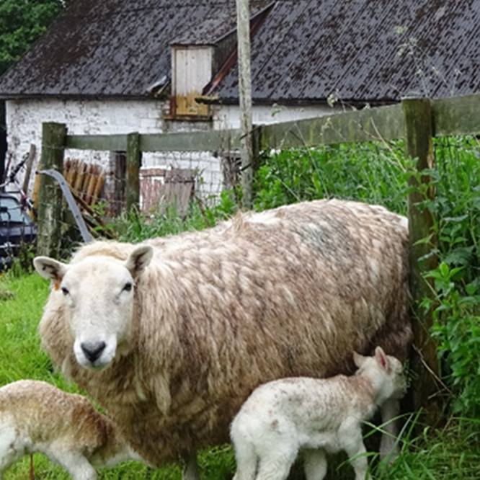
PROS
Welfare – reducing pain, we all want this
Effects on pain responses in later life
Productivity – better growth

Slide 6
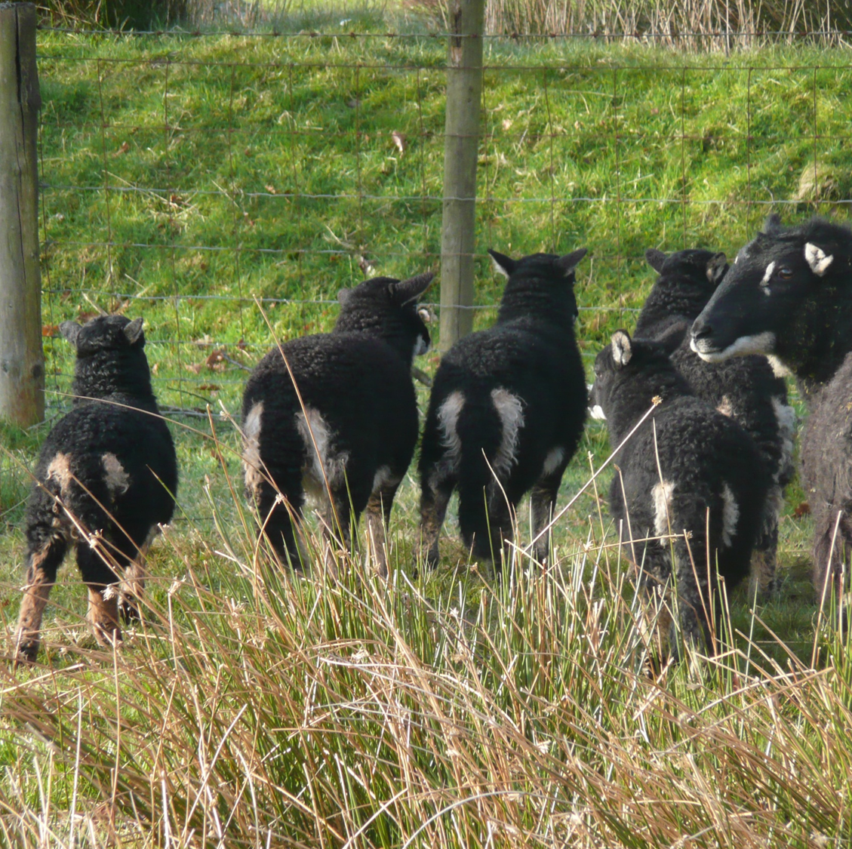
CONS
No licensed products.
Multiple injections – needles/bottle broaching. Training.
Prescribed “off licence” by vets under cascade.
  Record keeping requirements
  Vet could be held responsible for any adverse effects

Slide 7
Records of products administered to a food-producing animal under the cascade
24. A veterinary surgeon administering a veterinary medicinal product to food-producing animals under the cascade, or permitting another person to administer it under that veterinary surgeon’s responsibility, must, as soon as is reasonably practicable, record—
(a)the date of examination of the animals;
(b)the name and address of the owner;
(c)the identification and number of animals treated;
(d)the result of the veterinary surgeon’s clinical assessment;
(e)the trade name of the product if there is one;
(f)the manufacturer’s batch number shown on the product if there is one;
(g)the name and quantity of the active substances;
(h)the doses administered or supplied;
(i)the duration of treatment; and
(j)the withdrawal period,
and must keep the record for at least five years.

Slide 8
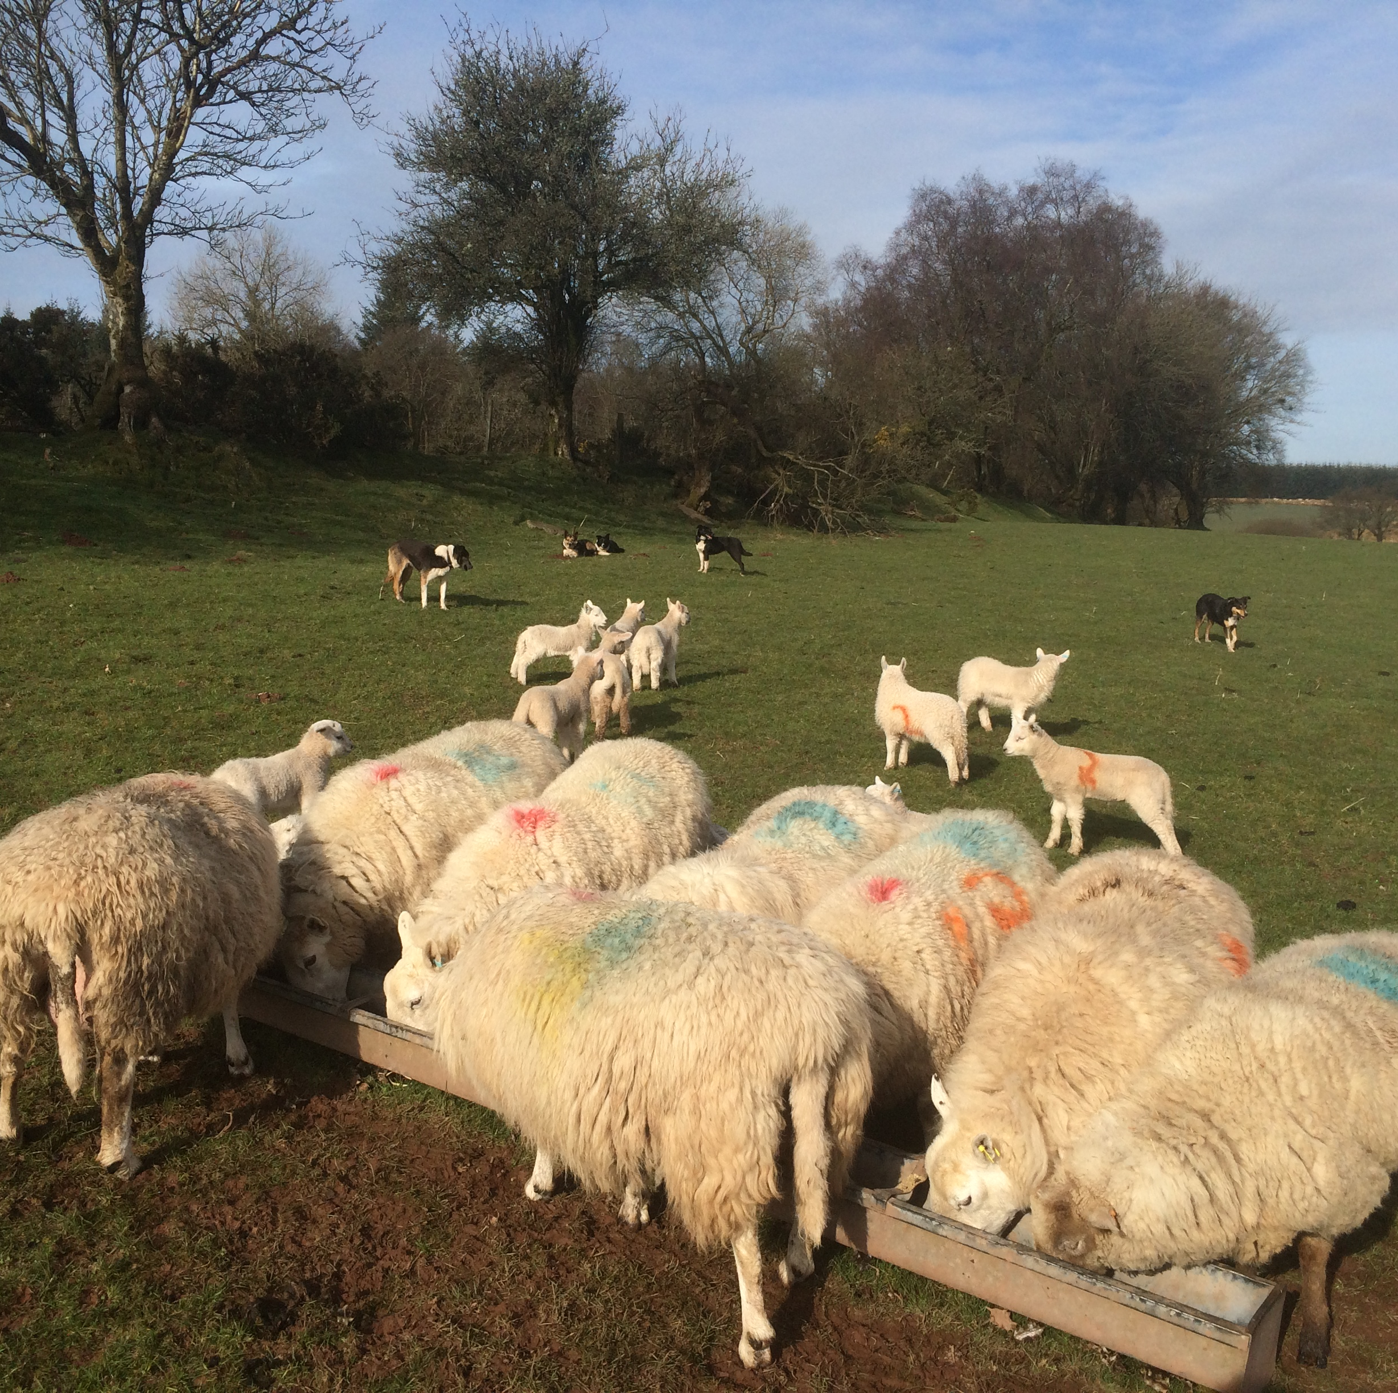
What do we need
Licensing of current medicines
More work/trials on use in young lambs
Clarification from VMD to vets on their stance re cascade
New products in future
Notes:
New products as knowledge of pain pathways and control progresses – not known in humans yet.

