Slide 1
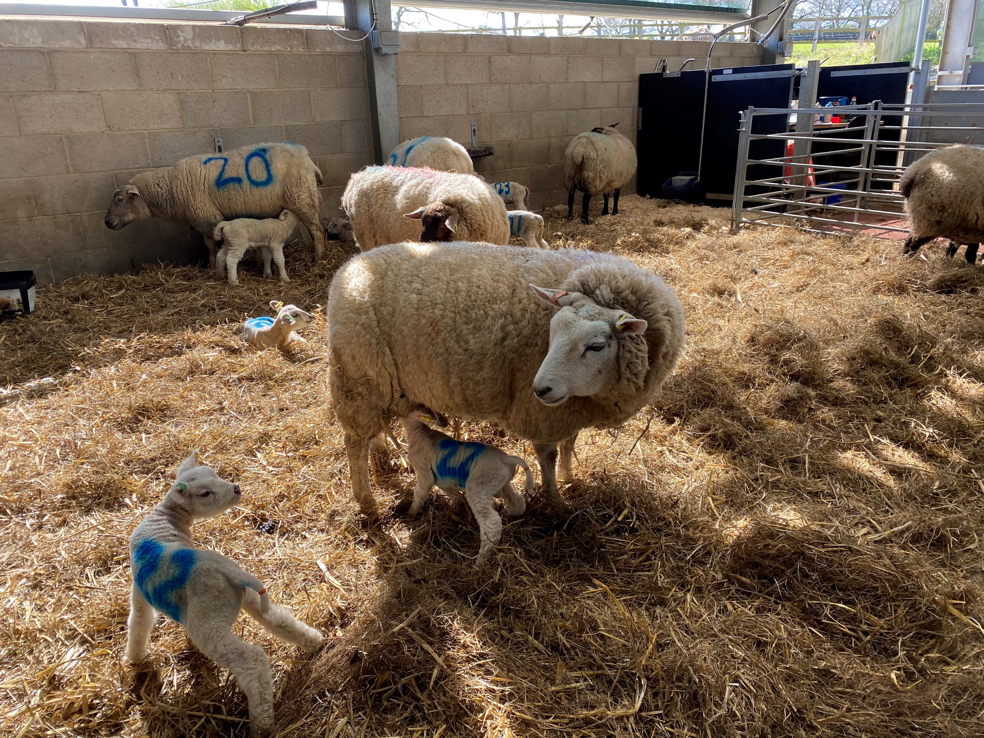

Understanding the tailing and castration consultation and helping members to respond

Slide 2

How did we get here?
All 4 UK nations responding to a panel of animal welfare experts and vets – the Animal Welfare Committee (AWC) - have been ramping up pressure on the government to review this law. It began initially in 1994, was discussed again in 2008 and then again December 2022.
The Animal Welfare Committee’s 42-page opinion discusses future strategies for tailing and castrating lambs.
A strategic aim is to move away from routine castration and tailing, and to use pain relief and methods to reduce pain if it takes place
This is the basis of the consultation

Slide 3
Causing real concern
Not surprisingly the majority of sheep farmers seem to be opposed to the proposals and question the importance of the level of pain caused. Ringing is fast, easy, cheap.
The consequences of not castrating or tailing could lead to worse welfare problems and market problems, and pain relief is currently impractical.
Wider supply chain problems too.
But views vary and many farmers are already moving away from routine castration and tailing and even selecting for shorter tails, suggesting people are increasingly aware.
The proposals do offer a solution to upland and outdoor/late lambers in England and Wales who don’t gather before 7 days.
The consultation process is questionable!

Slide 4
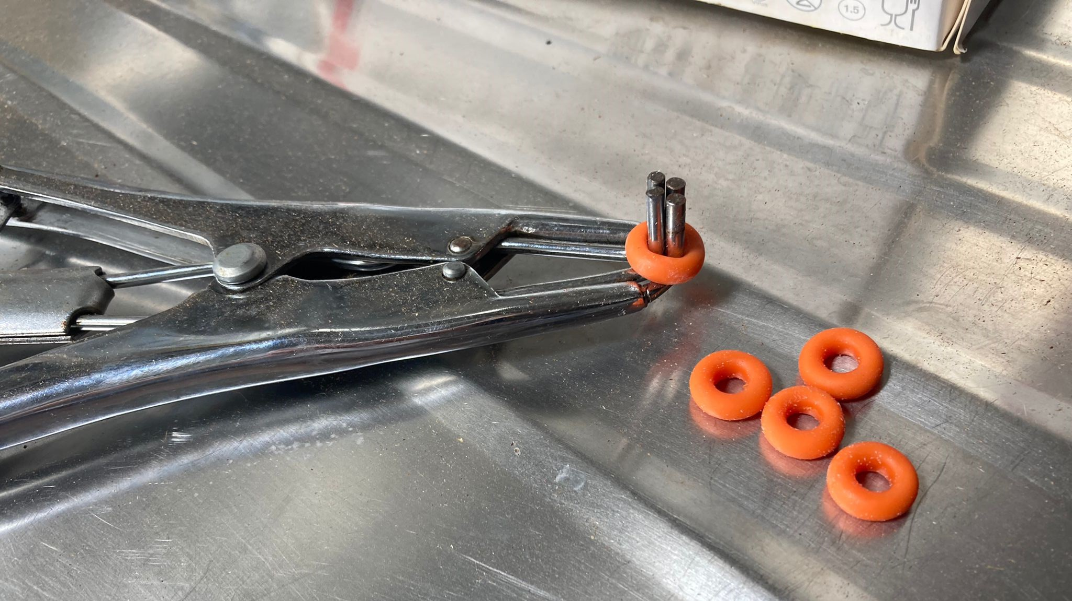
Consultation outline
Consultation opened on 12th Jan and closes 9th March
Clear that administrations want to take steps and to unify, but do want to listen to feedback and get expert opinions
In particular they want to know if choices differ between different sizes and types of farm (but we know that sheep farming is diverse, and for very good reason).
The law won’t change on 9th March – it could do for 2028 but administrations accepting change may take longer.

Slide 5
Current legislation
2007 acts permit these procedures – procedures that affect tissues are outlawed otherwise
Rubber rings and clips are allowed up <7 days of age without pain relief
Pain relief mandatory thereafter
Hot knife requires pain relief in England and Wales, not in Scotland
Clips allowed without pain relief <7 days of age in England and Wales
Clips allowed without pain relief up to 3 months of age in Scotland

Slide 6
The proposals
Move away from routine practice — encourage minimising the use of castration and tail docking where possible.
Minimise pain — require that, where these procedures are carried out, pain is appropriately reduced (using less painful methods, anaesthesia and/or analgesia).
UK-wide consistency — ensure rules are consistent across England, Wales, Scotland and Northern Ireland.
Only after 24 hours old — prohibit castration/tail docking before lambs reach 24 hours old.
Surgical methods restricted to vets — any castration or docking using a knife/blade must only be done by a veterinary surgeon with both anaesthetic and analgesic.
Rubber ring with pain relief up to 3 months — allow rubber ring castration and tail docking up to 3 months of age only with anaesthetic and analgesic.
Burdizzo/clamp with pain relief up to 3 months — permit clamp (Burdizzo) use up to 3 months with pain relief.
Clip method allowed without pain relief — permit clip-type systems (e.g. Clipfitter) for lambs up to 3 months without mandated pain relief as they are considered less painful.
Remove the 7-day limit — allow certain procedures up to the age of 3 months, with pain relief.
Hot iron only with pain relief — allow hot iron tail docking up to 3 months only with anaesthetic and analgesic.
Lambs over 3 months by vets only — Older lambs may only be castrated or docked by a veterinary surgeon using pain relief.
Training requirement — require stockkeepers/farmers to be appropriately trained and competent before performing any of these procedures.

Slide 7
Consultation – What to expect
1 Q1-7 About you – Confidentiality, name and address
2 Q8-24 Multiple choice statements followed by explanation
e.g. 10.a) Rubber ring castration of lambs up to 3 months should only be permitted with an effective anaesthetic and analgesic.
3 Impact Assessment Q25 – end (Q36)
De minimis - £1.6bn over 10 years from consumers paying more (£11.25/household/year)
Time – 60 seconds to administer analgesia and anaesthesia
Your farm and blowfly
Segregation of male and females

Slide 8
Consultation – What to expect
Q28
Read and consider carefully
You select the method and age of castration/taildocking

Slide 9
Tips for responding
Do respond – opinions will count
Give yourself a minimum of an hour and don’t try on a smart phone
Use the save and continue function – this ensures progress isn’t lost and gives you chance to come back
Your farming context matters, give detail
There are blank boxes throughout – you can write any opinions in there.
IF YOU CAN’T DO IT ALL THEN DO WHAT YOU CAN
Please complete it before the deadline of 9th March

