Slide 1
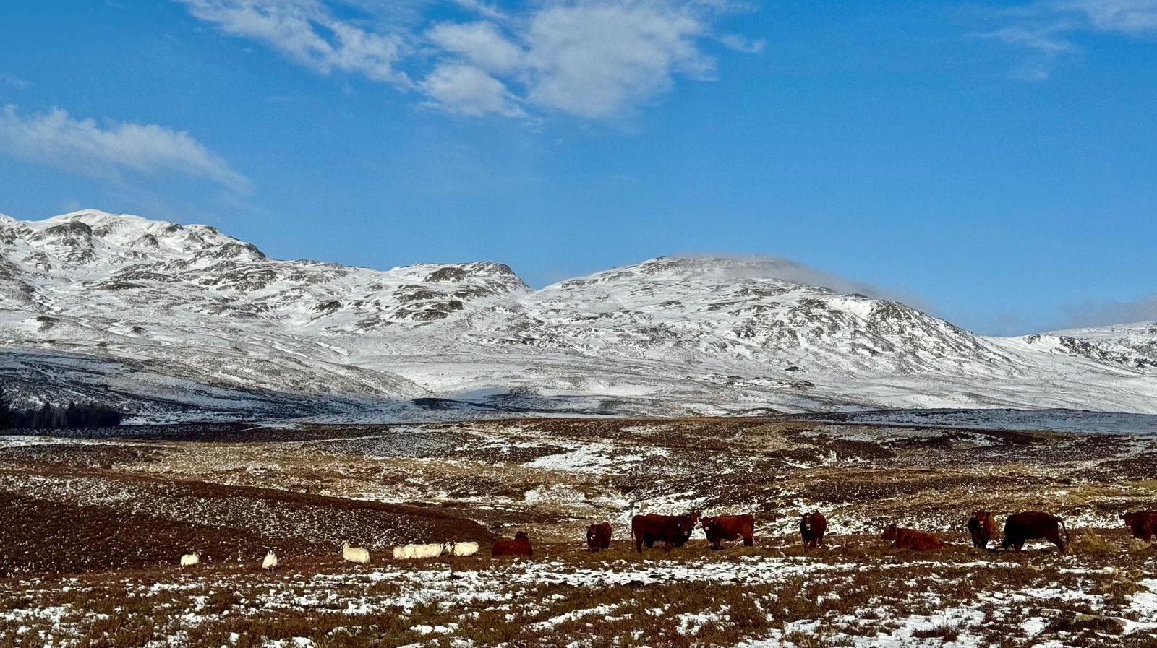
Available options for castrating and tail docking
Understanding the tailing and castration consultation: A guide for sheep farmers

Slide 2
Available options for castrating and tailing
Not castrating & tailing
Rubber ring (normal / short scrotum)
Rubber ring + NSAIDS
Rubber ring + local injection (Numnuts)
Local impregnated rubber ring (Lidoband)
Burdizzo
Clip (ClipFitter)
Surgical
Avoidance strategy
Ischemic methods
Crush methods
Excisional methods

Slide 3
Not castrating and tailing
Pros
No procedural pain
Lower labour requirement
Cons
Management ram lambs
Carcase penalties
Flystrike (selection!)
Aesthetics
Better growth rate
No risk of complications
Works best in early lambing lowland flocks who fatten lambs and sell direct to abattoir / costumer.

Slide 4
Rubber ring - normal
Pros
Quick
Widely understood and accepted
Cons
Causes pain
Under 7 days
Risk of infection
Risk of misplacement
Simple
Cheap
Pain:
Welfare concerns
Reduced suckling
  Hypothermia
  Dip in growth rate
Risk for mismothering
Increased lying time → predation
Reduced immunity & stress
Short scrotal:
Pain still significant
Growth rates close to entire males
Better feed conversion
Ram like behaviour

Slide 5
Rubber ring + NSAIDS (meloxicam)
Pros
Improves behavioural recovery
Widely understood
More expensive
No licensed NSAIDs in sheep
Less pain after the first few hours
Still acute pain at application
Use under 2 week old
Reduces inflammation
Cons

Slide 6
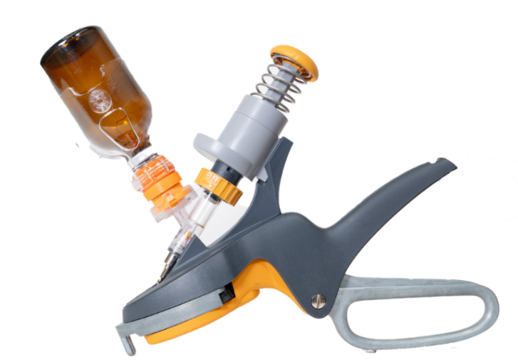

Rubber ring + local anaesthetic injection
Pros
Practical for large-scale systems
Ring placement widely understood
Cons
Cost
Only works for a shorter time
Lidocaine not licensed
Reduces acute pain at ring placement
Lambs over 7 days
Quick

Slide 7
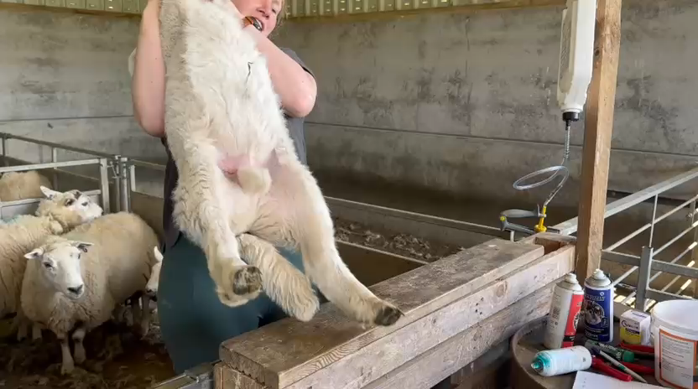

Slide 8


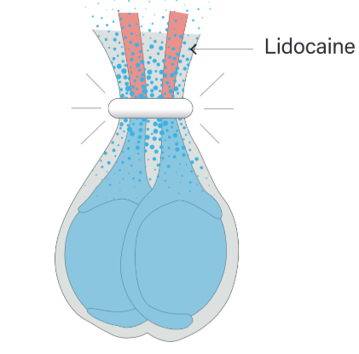
Local anaesthetic-impregnated rubber ring
Pros
Cons
Still acute pain at application
Long duration of pain relief
Limited effect on deeper cord pain (better for tails)
Not available in UK
Same technique as normal rubber ring
Better growth rates
Quick and easy to apply
More expensive

Slide 9
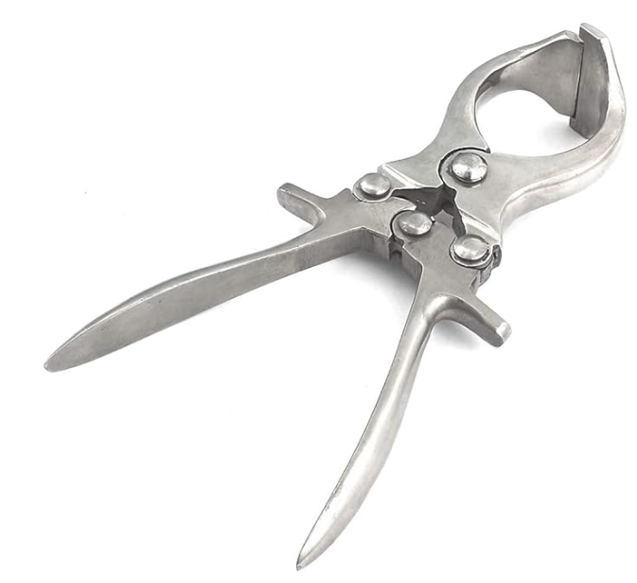
Clamp castration - Burdizzo
Pros
Cheap
Cons
Acute pain still significant
Technically demanding - training
Pain lasts less long
Lower success rate
No open wound
More time consuming
Lower infection rate
Sometimes used in combination with rubber ring to improve success rate.

Slide 10
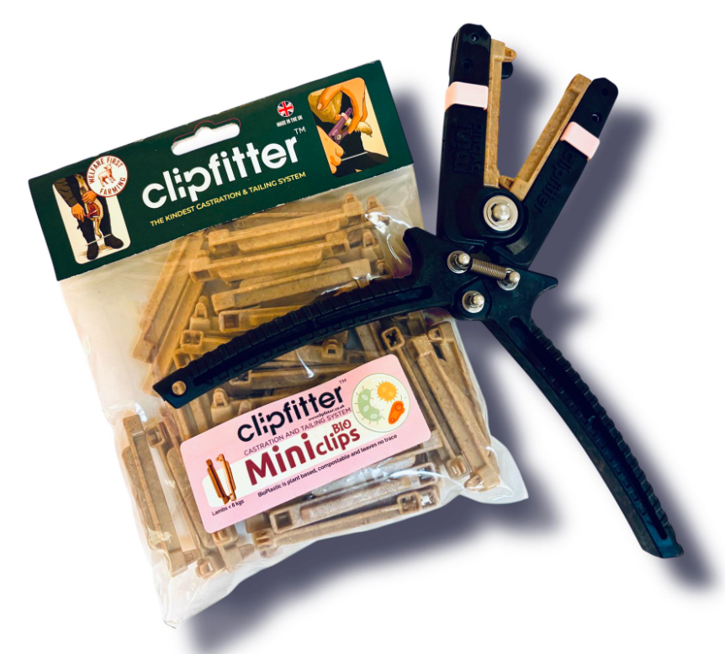
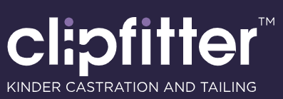
Clips
Pros
Cons
Cost
Training needed
Slightly slower
Not as ideal for bigger lambs
Lower pain response
Tissues shed more quickly
Practical for large-scale systems
Can be used in young lambs

Slide 11
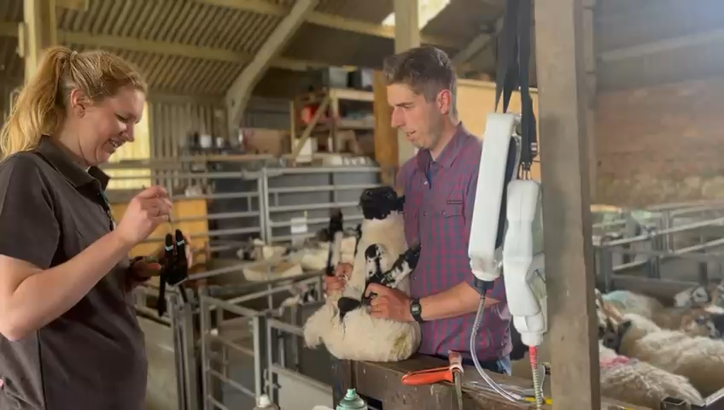

Slide 12
Surgical
Pros
Cons
Pain
Open wound
Requires none licensed NSAIDS + local
Immediate removal
With proper local and NSAIDs can be good welfare
More invasive
Older animals
Historically teeth were used to bite of testicles and tails were cut off.
Tails done with a hot or electric docking iron (cautery)

Slide 13
Take home messages
Welfare and pain management will only grow in importance
Pain matters (cost growth rate, mismothering, immunity)
There is no one-size fits-all
Stay open minded
Try before you commit
Good technique matters as much as the method
Think long-term (genetics, management)
Combination of different methods an option
(e.g. waiting till lambs are older, castrating smaller ones)

